Slide 1


Slide 2
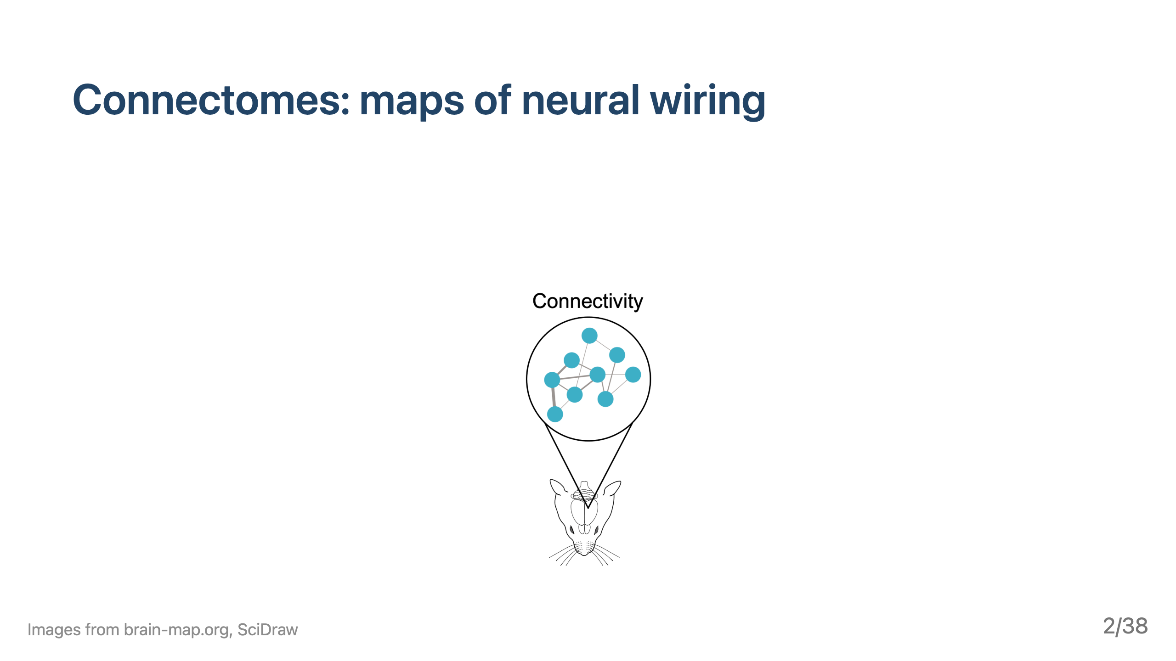

Slide 3
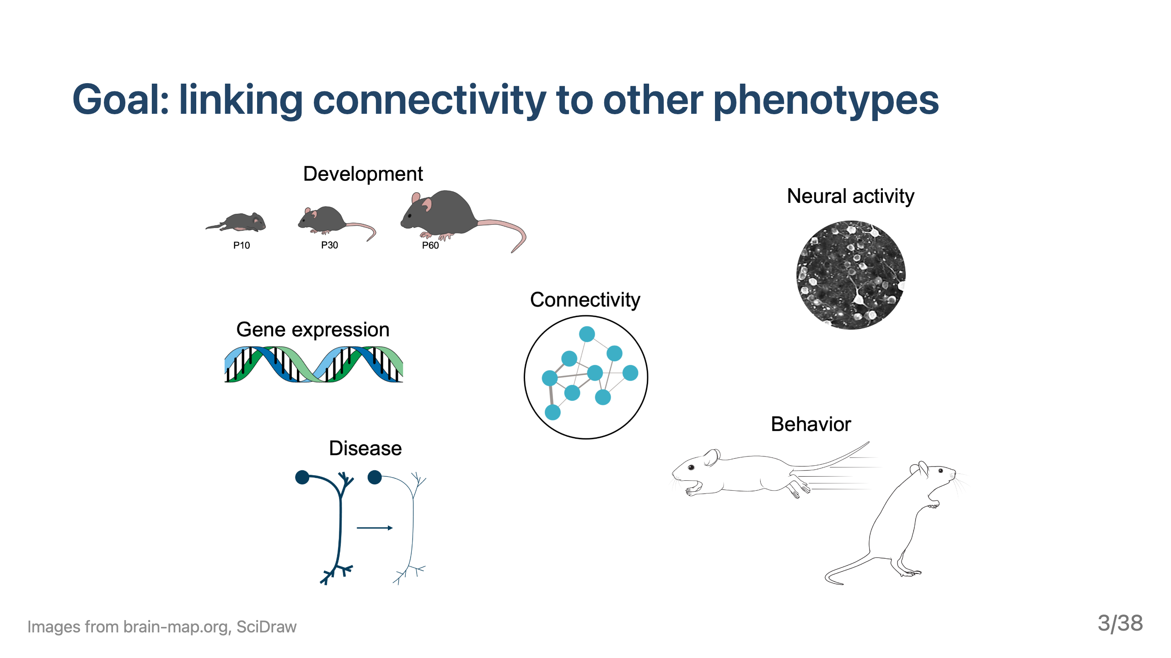

Slide 4


Slide 5


Slide 6


Slide 7
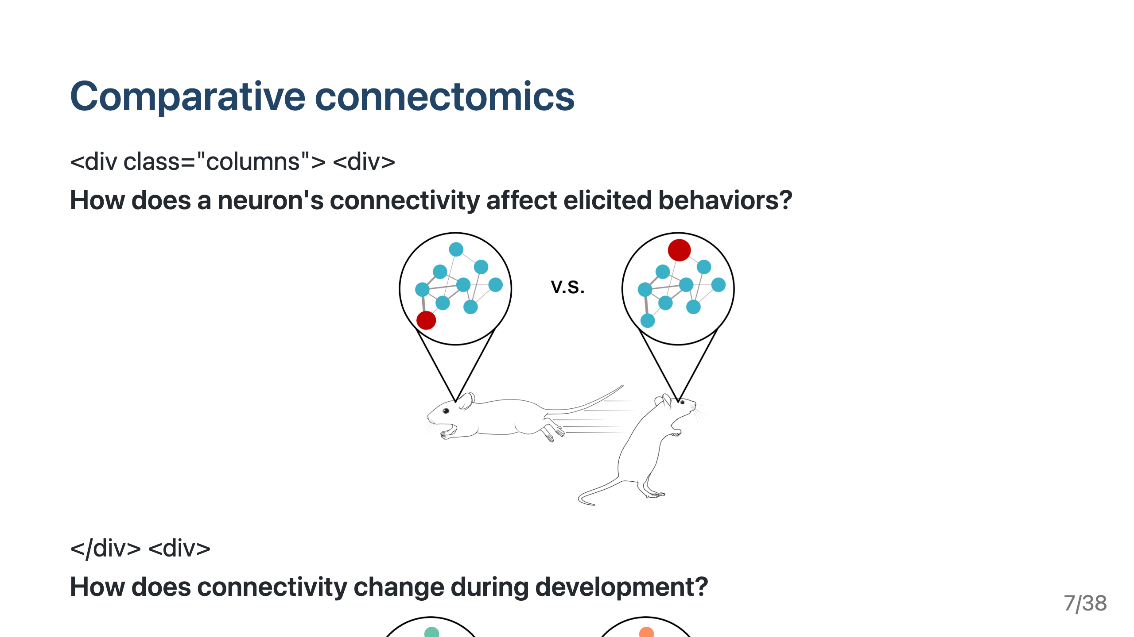

Slide 8
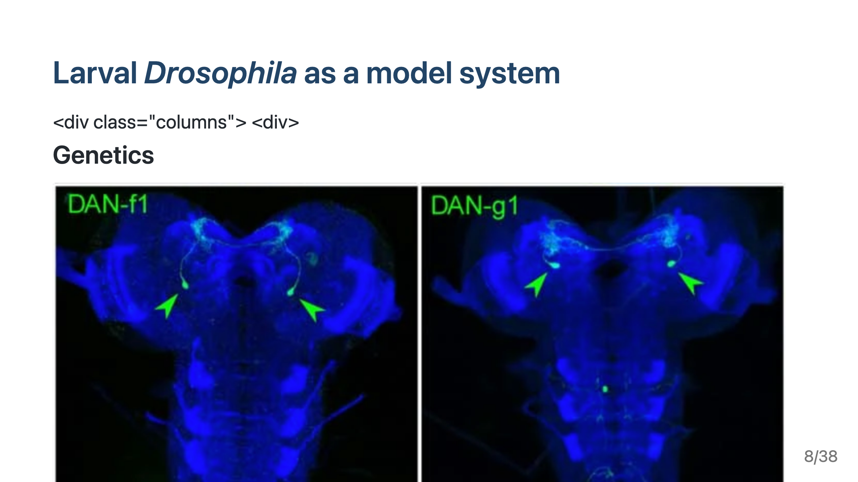

Slide 9
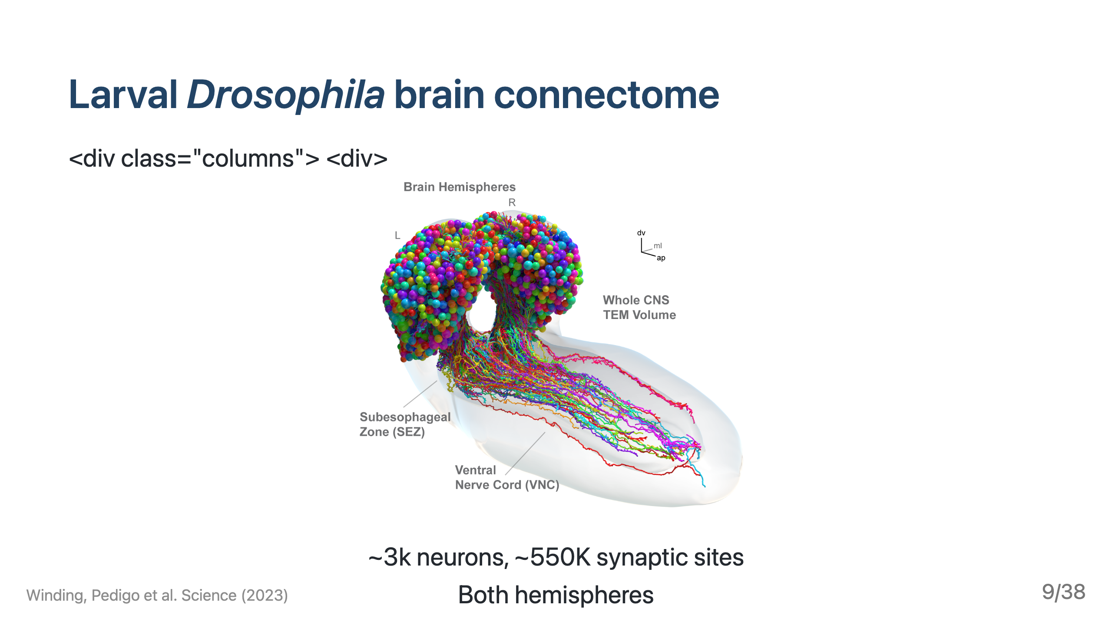

Slide 10
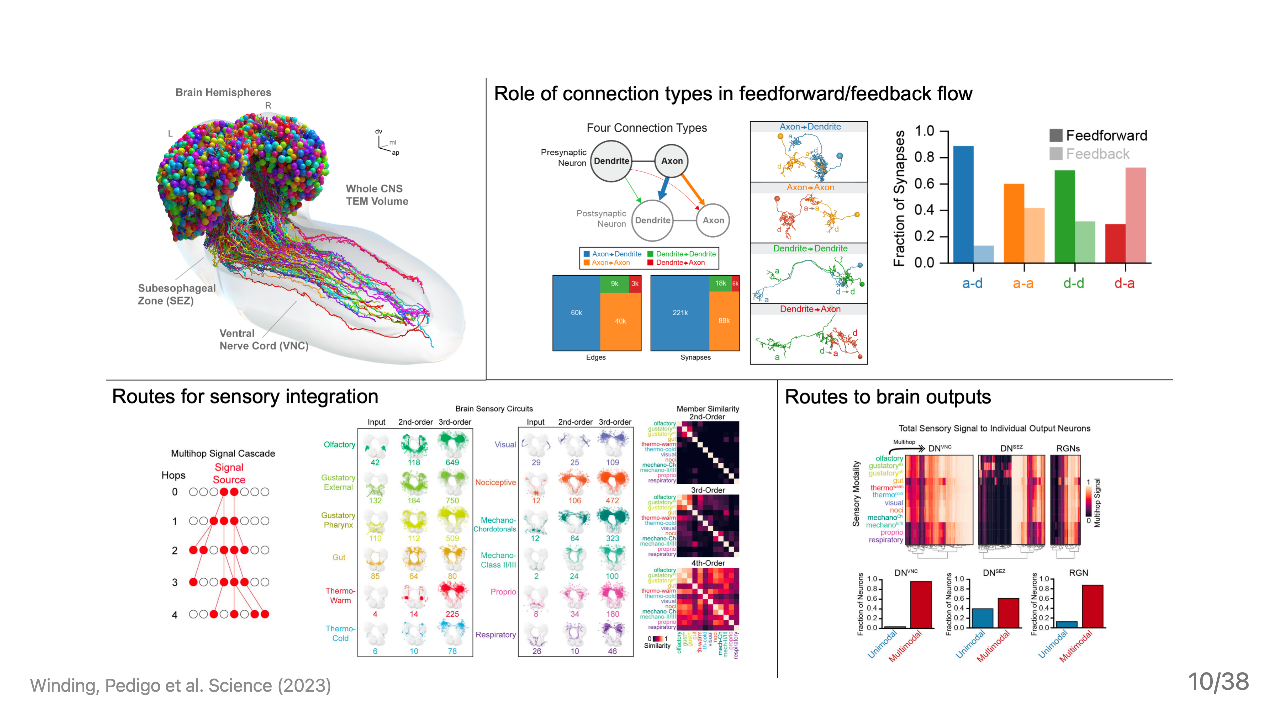

Slide 11
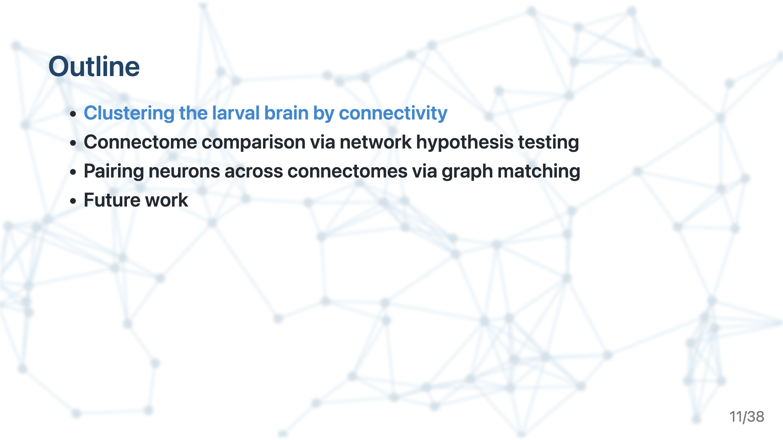

Slide 12
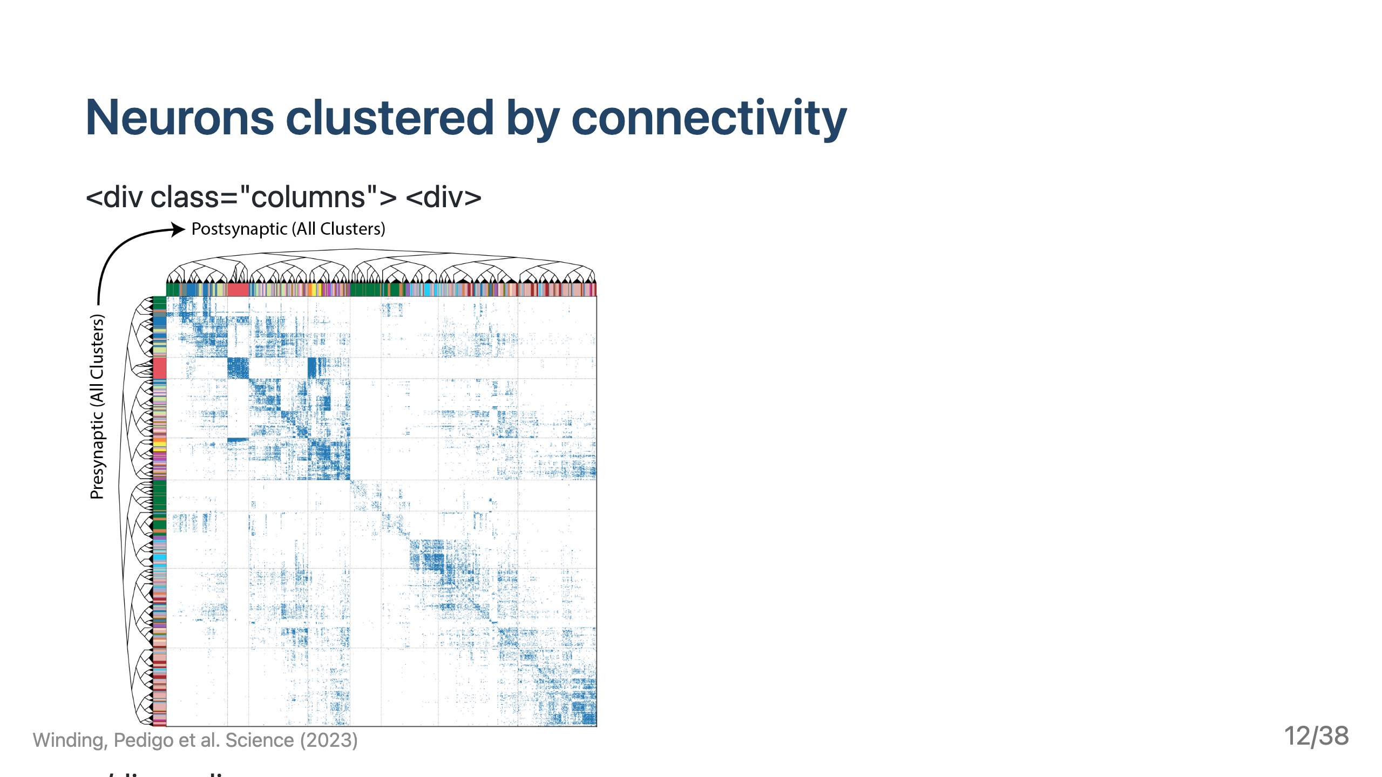

Slide 13
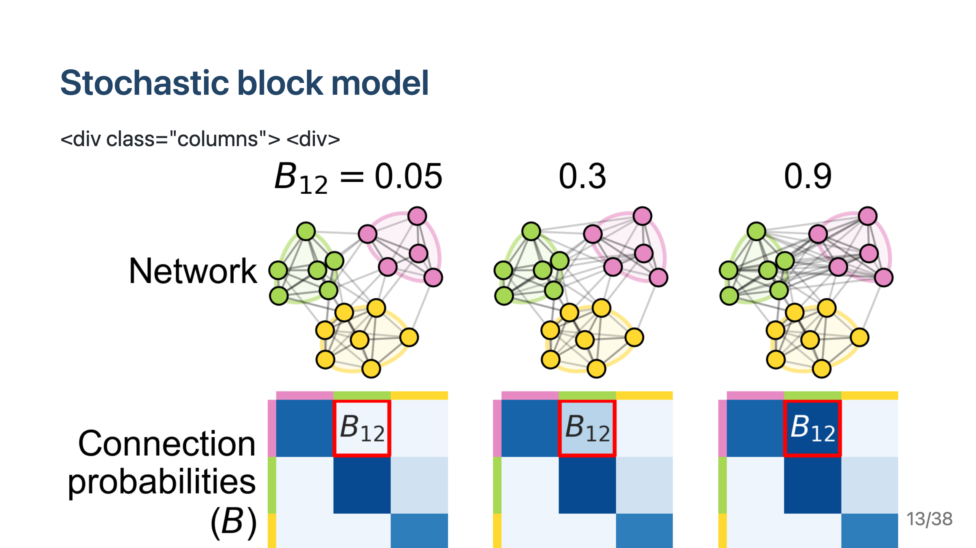

Slide 14
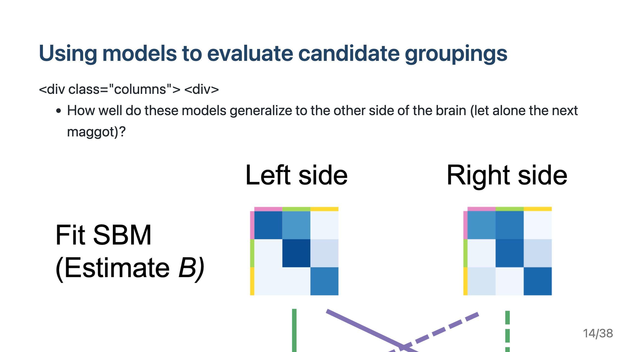

Slide 15
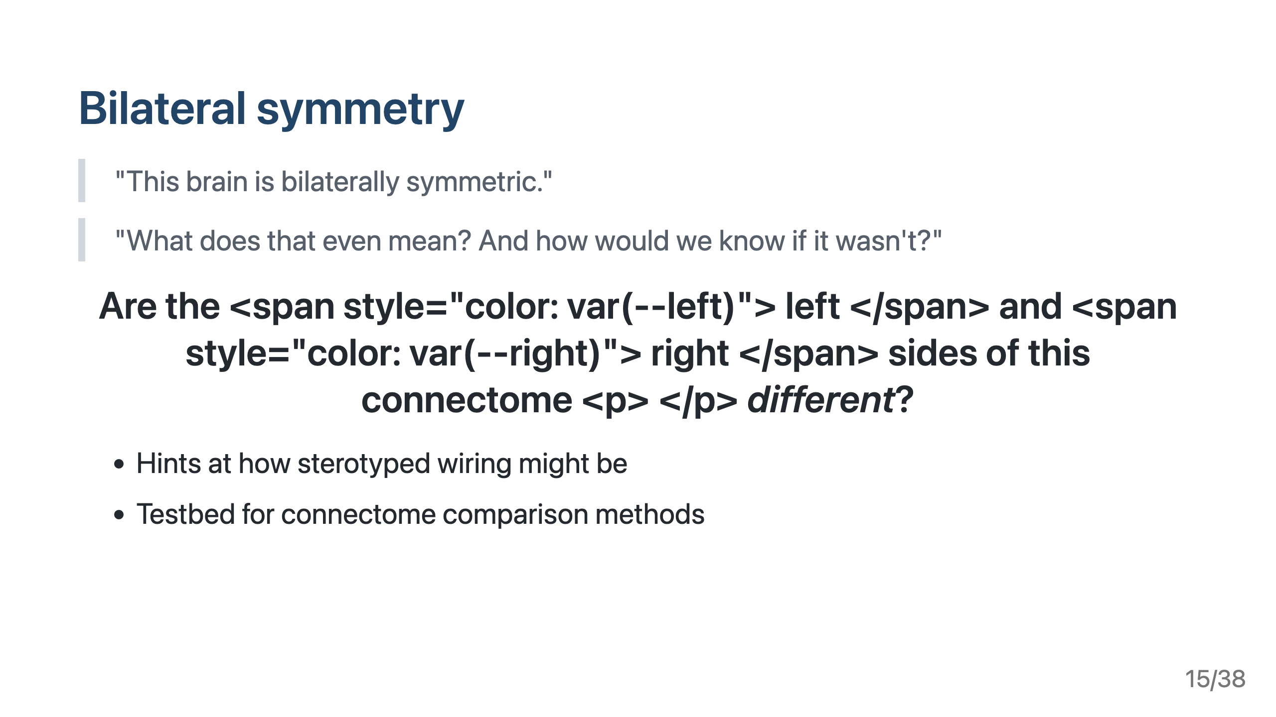

Slide 16
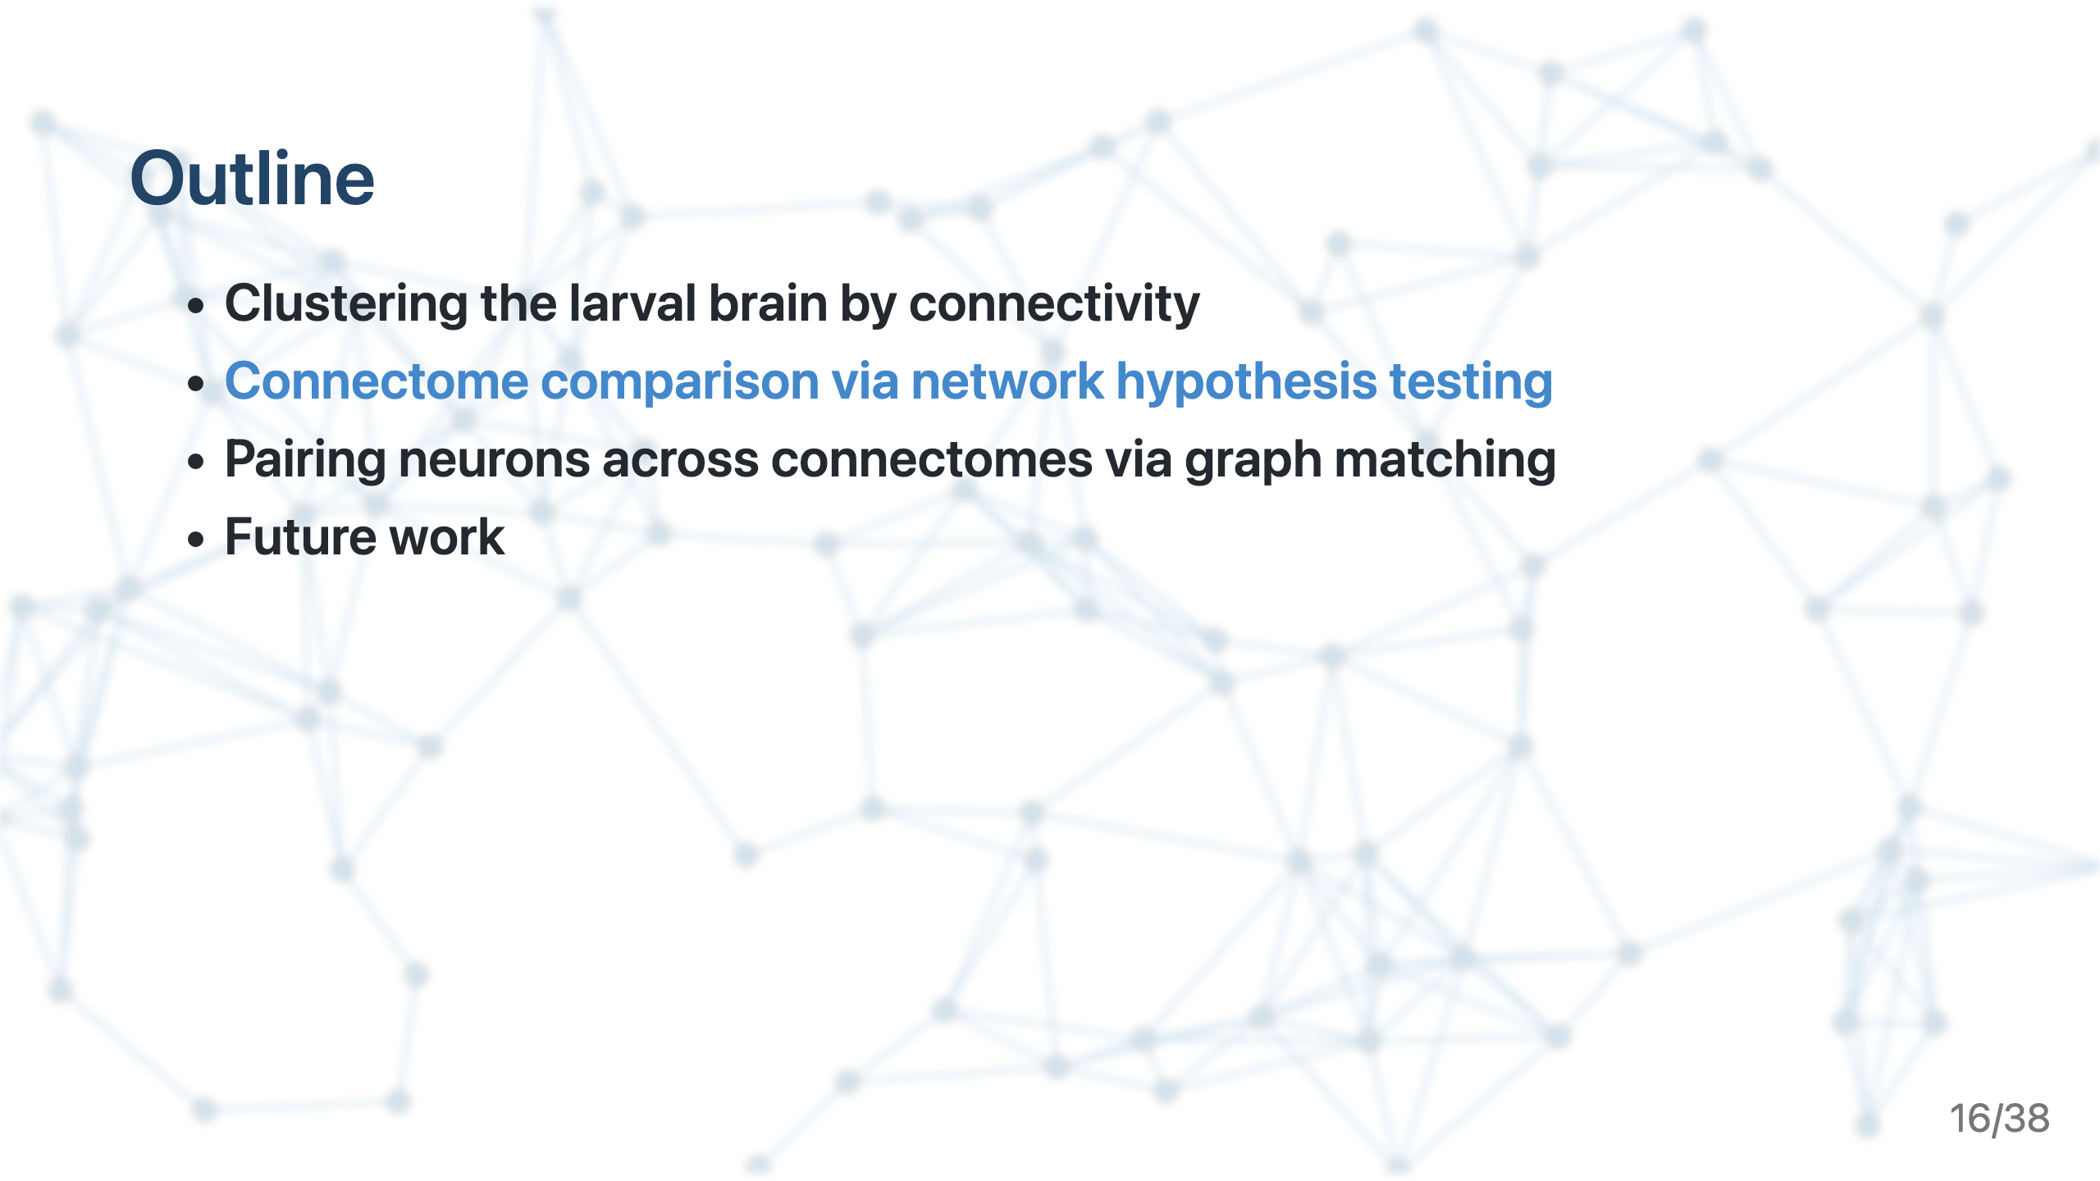

Slide 17
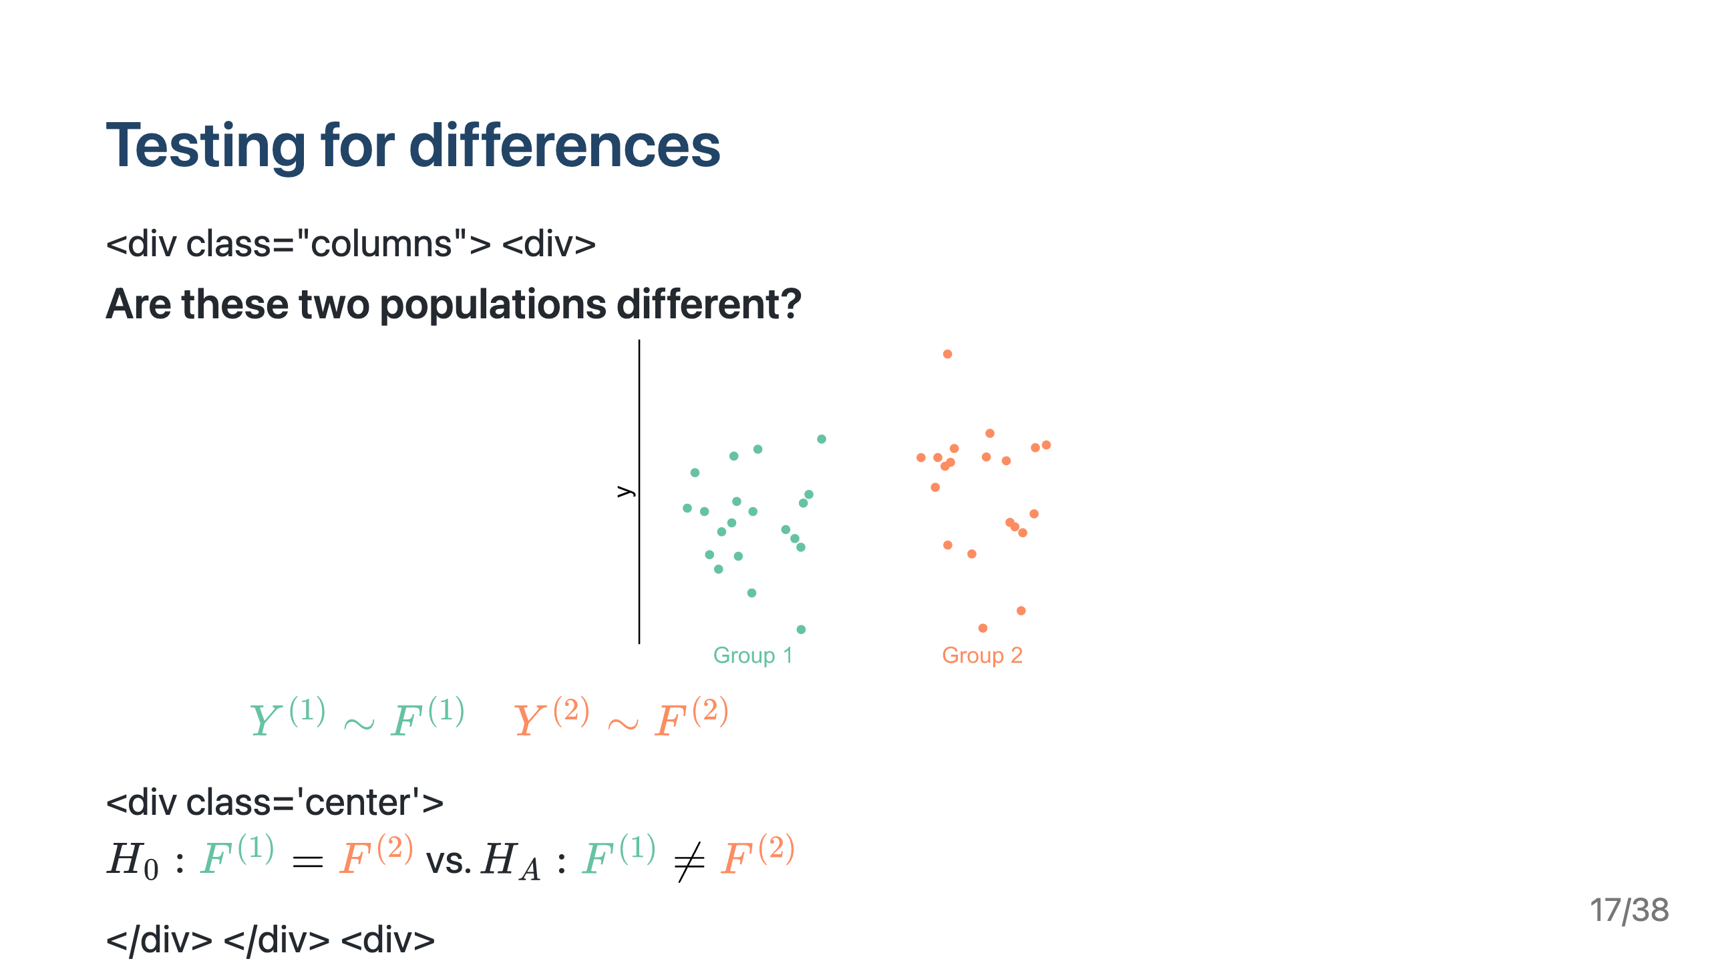

Slide 18
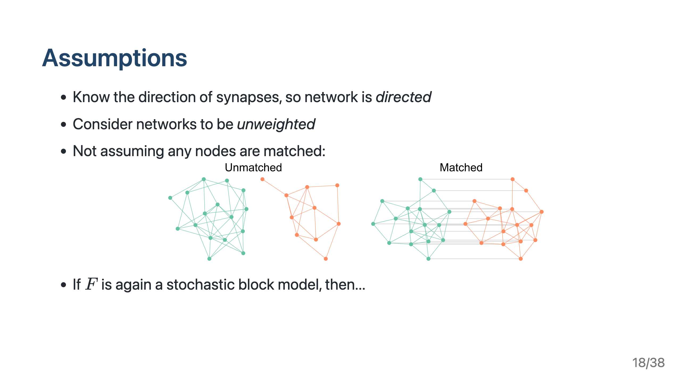

Slide 19
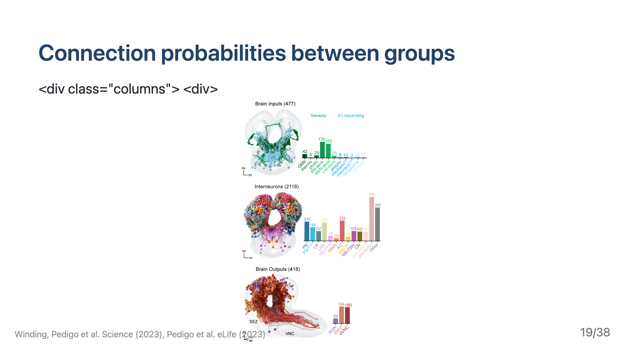

Slide 20
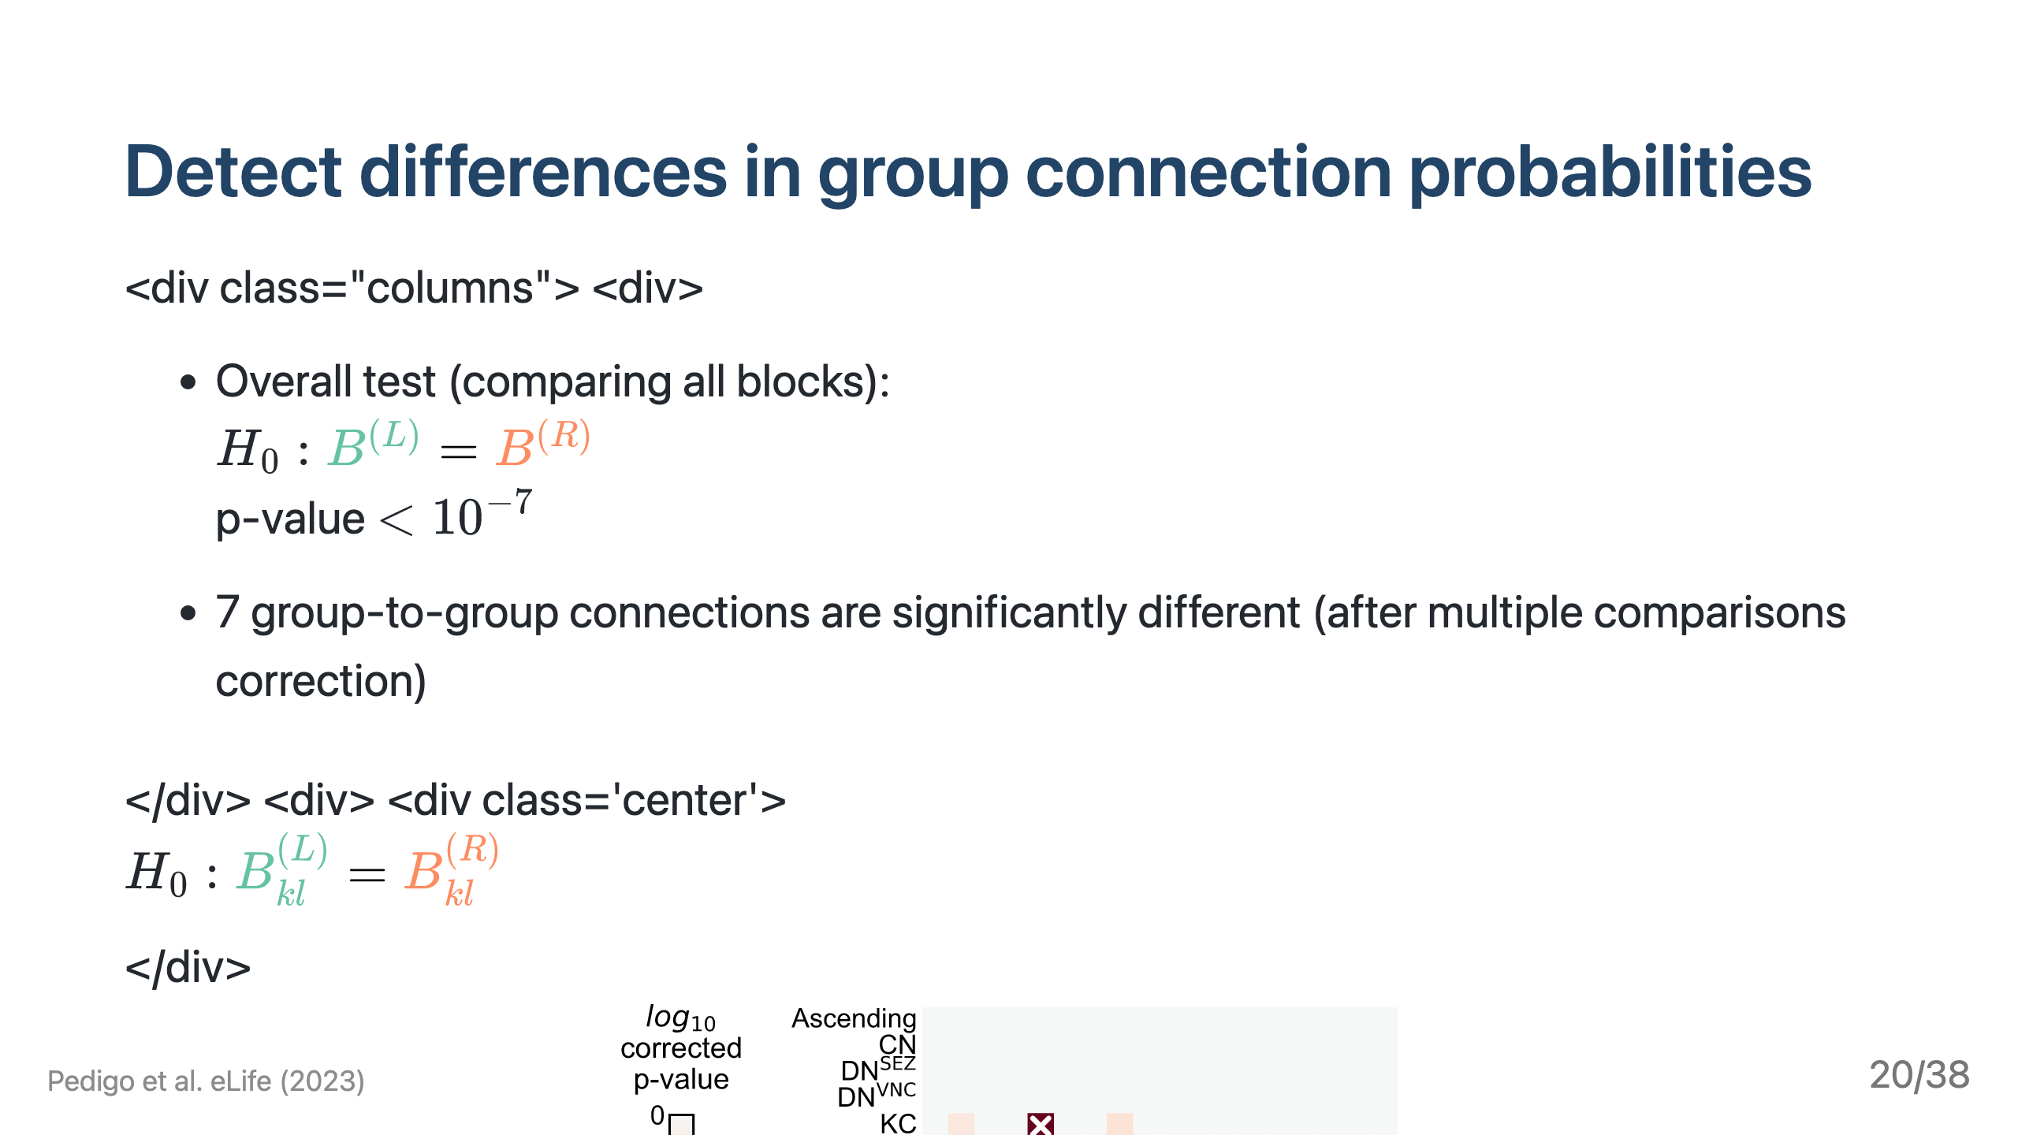

Slide 21
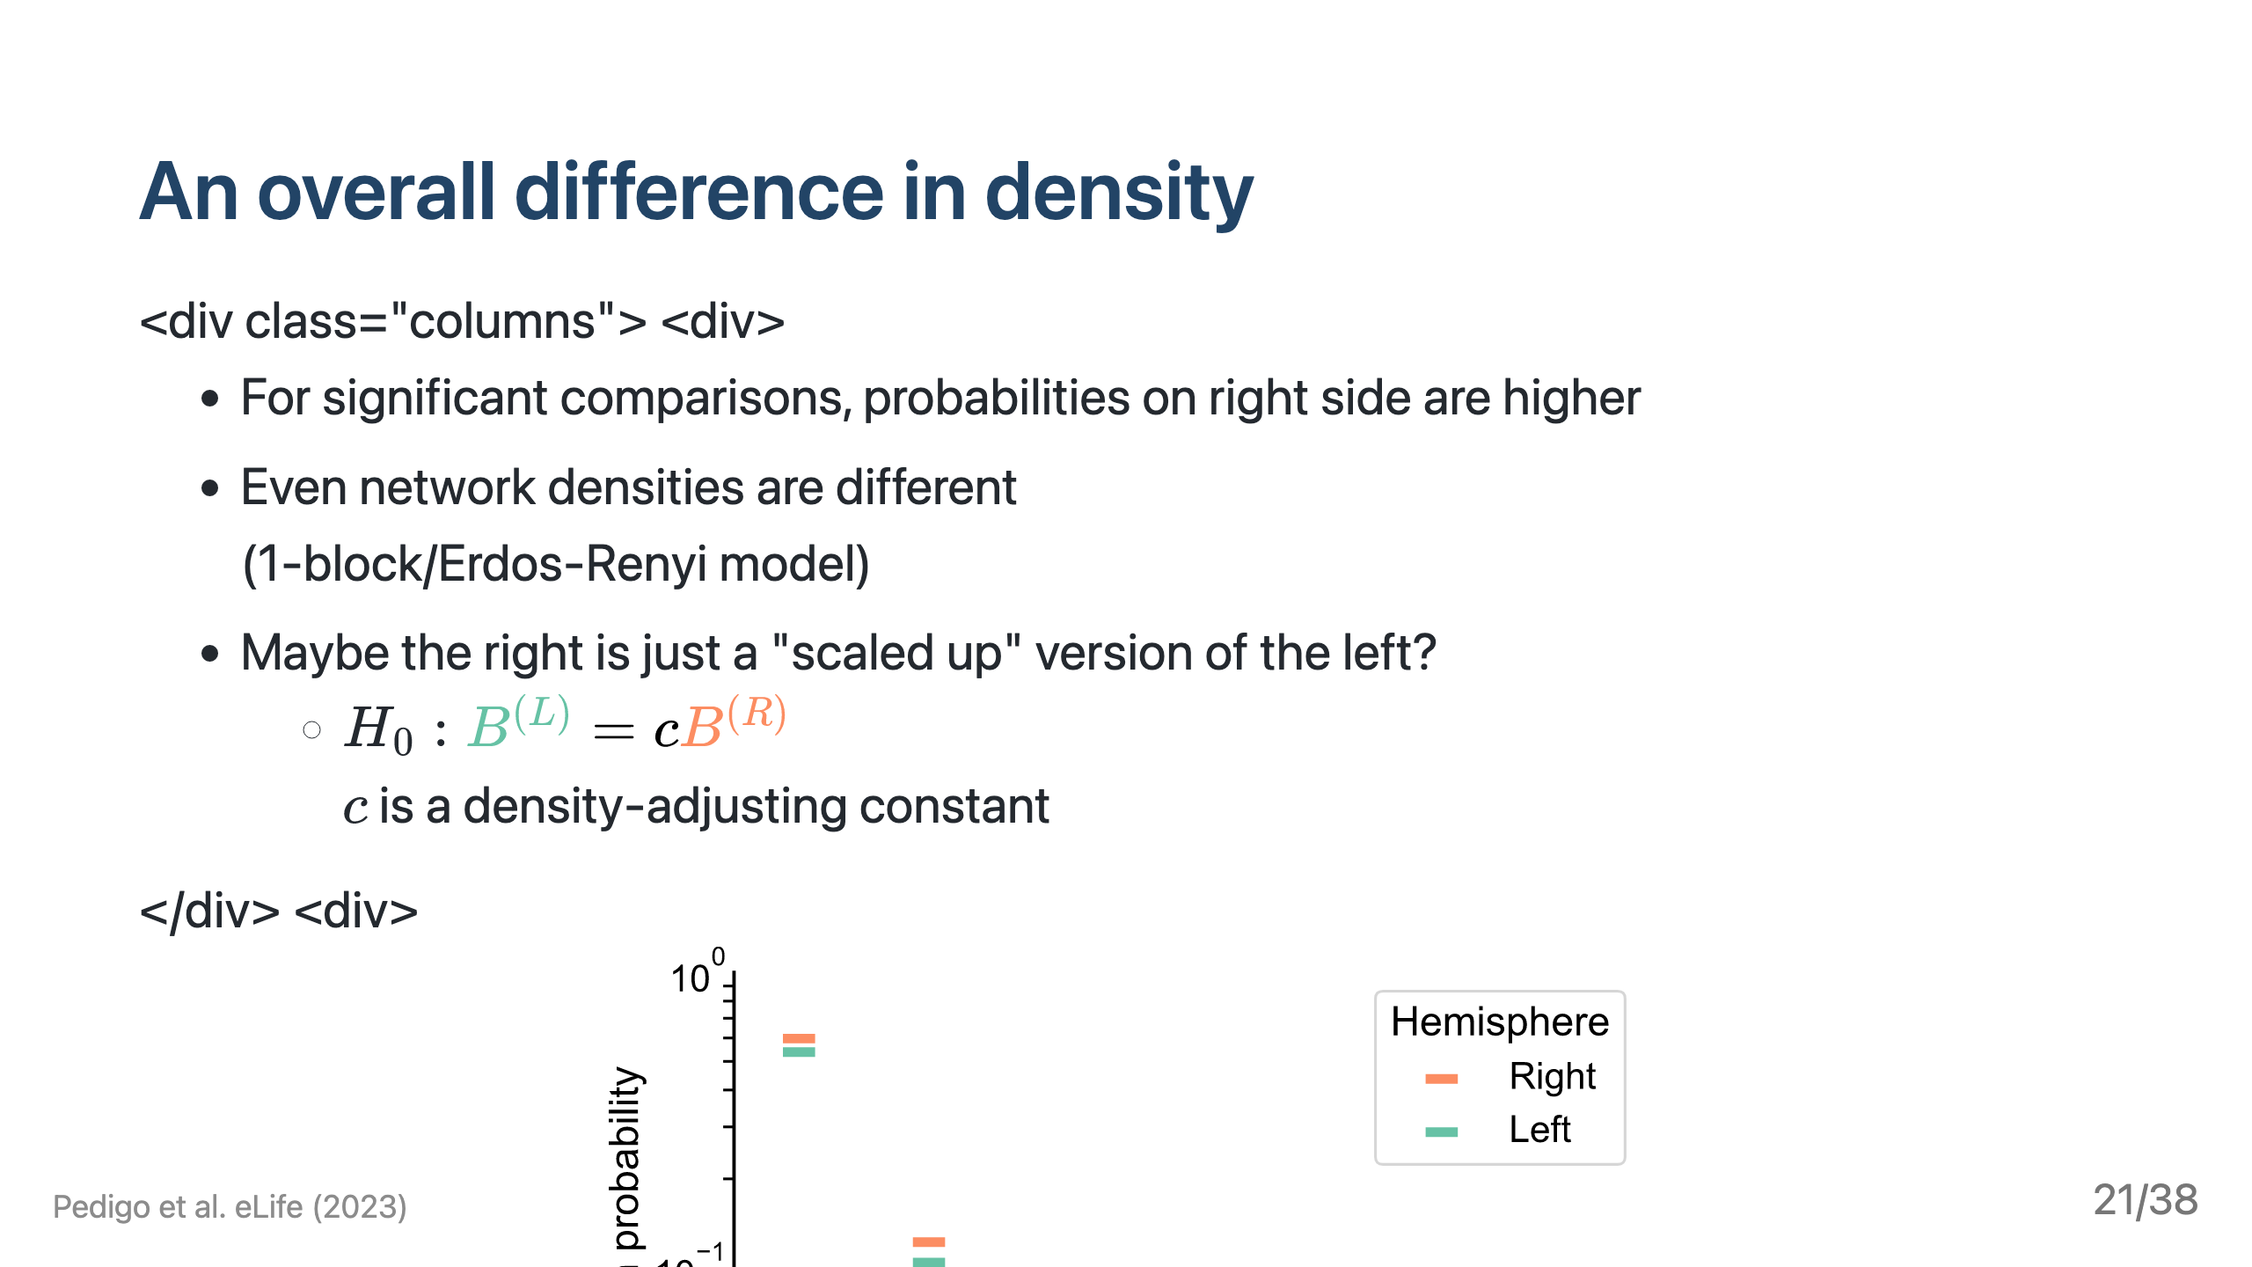

Slide 22
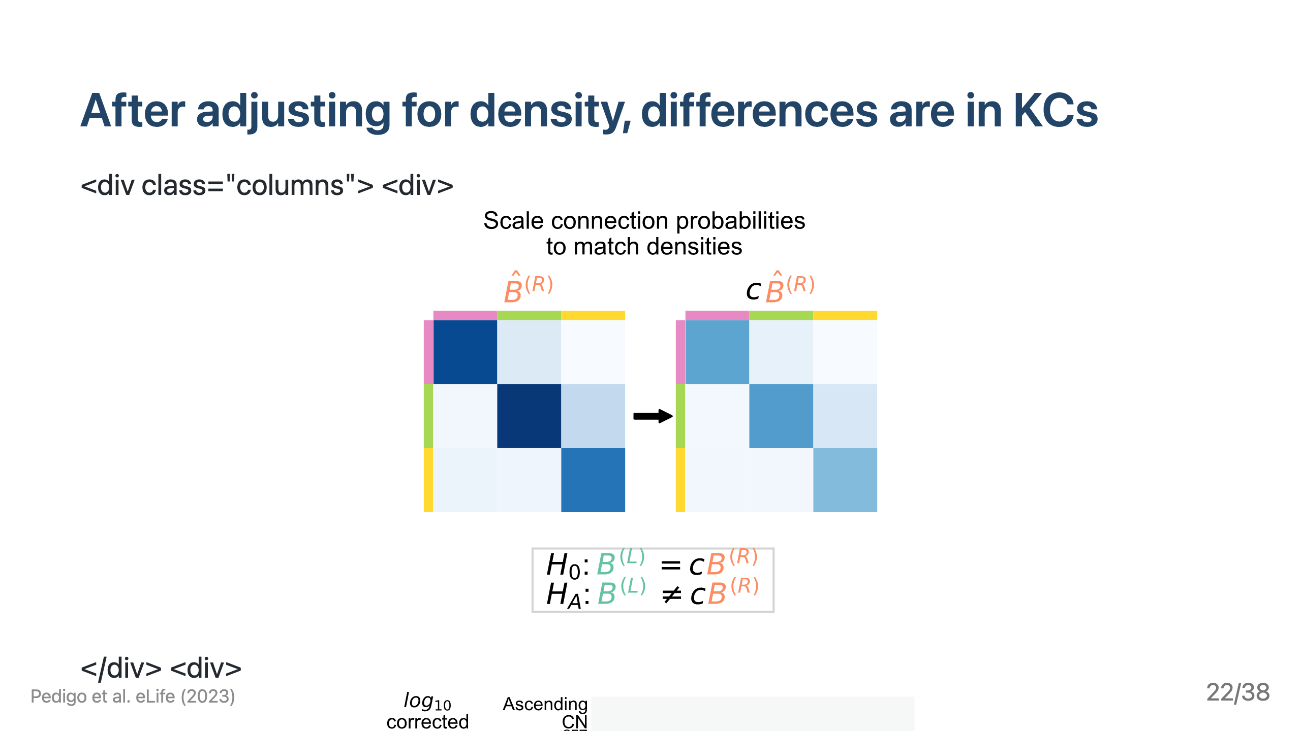

Slide 23
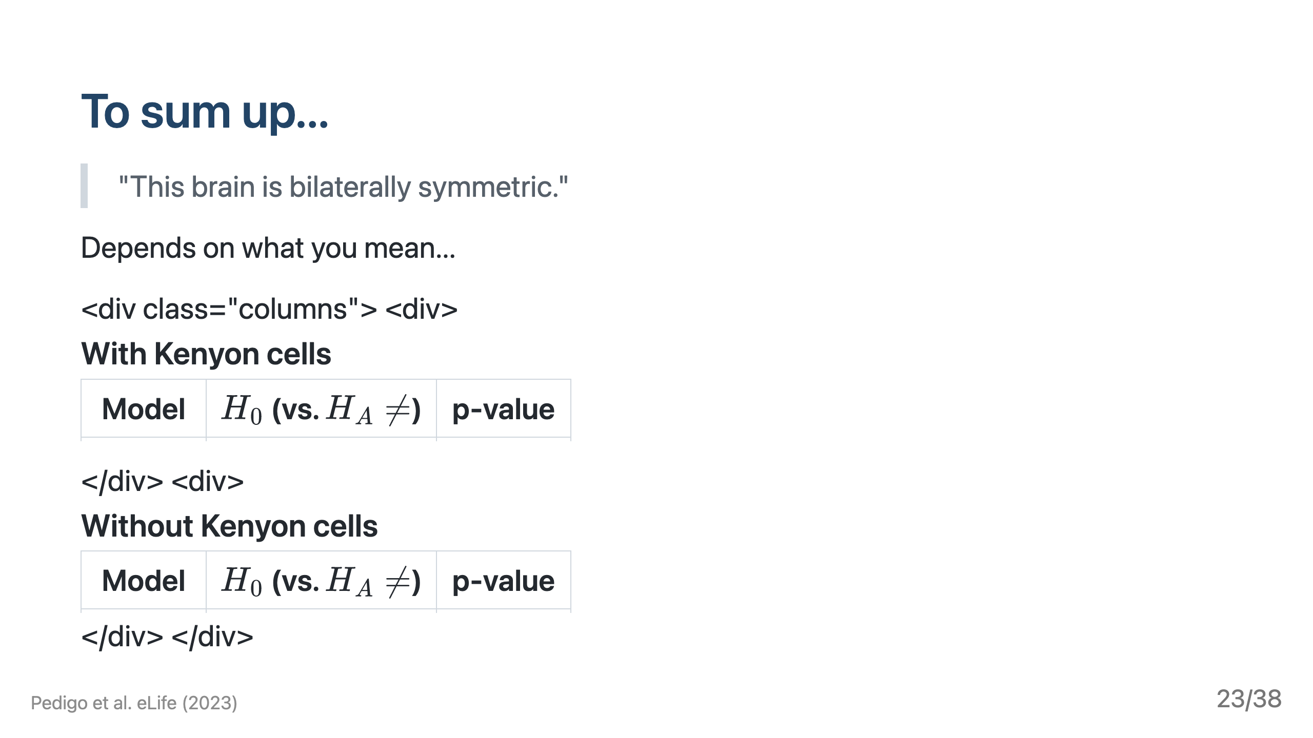

Slide 24
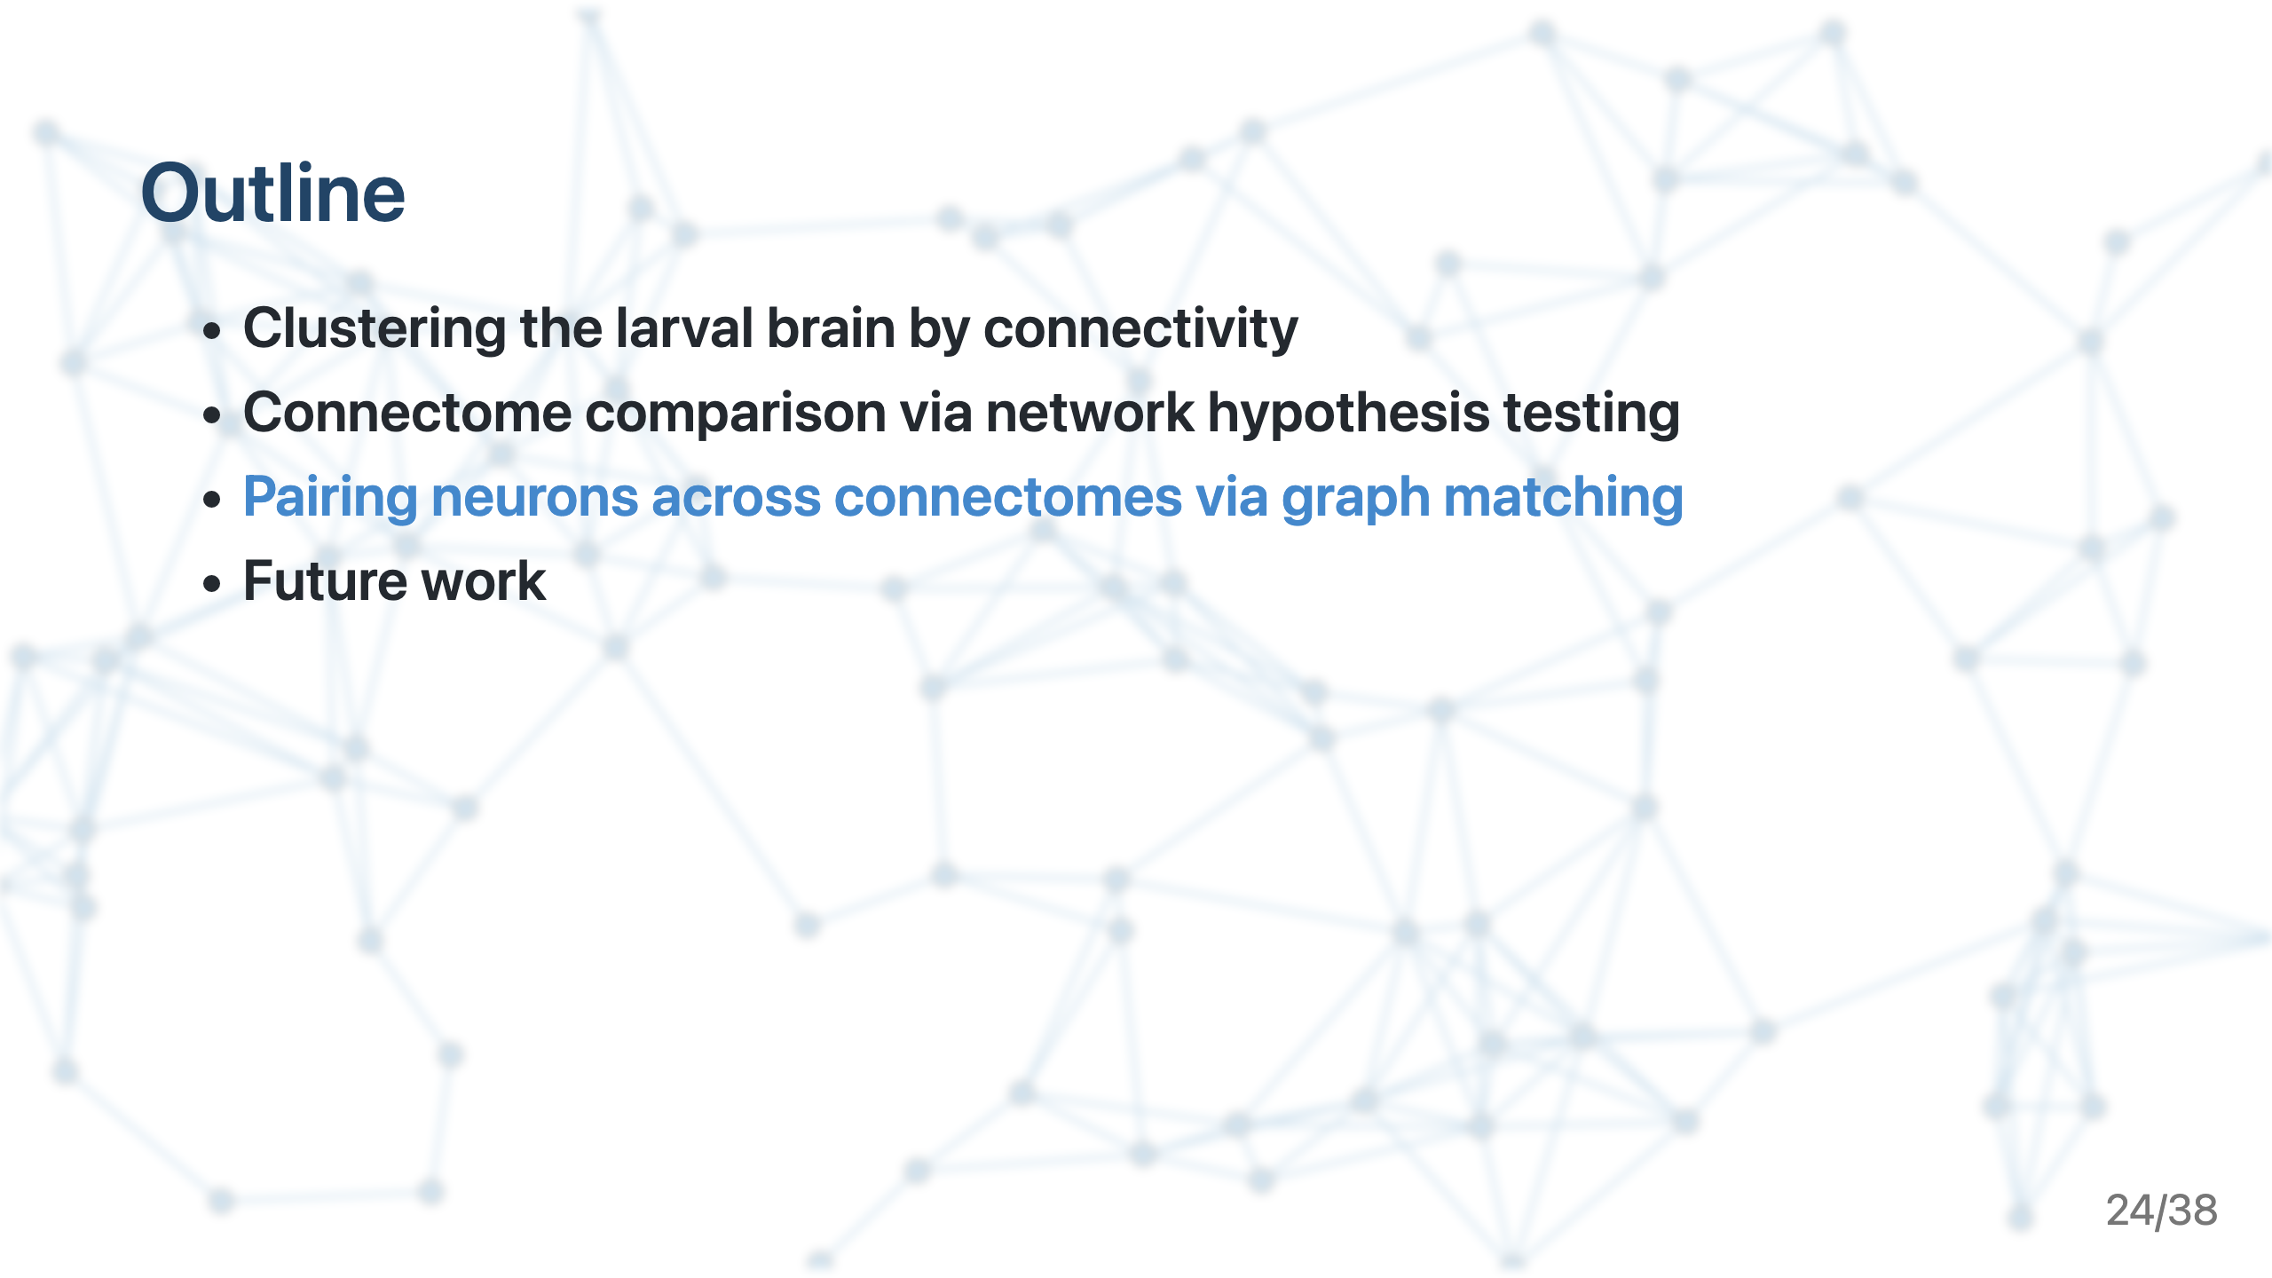

Slide 25
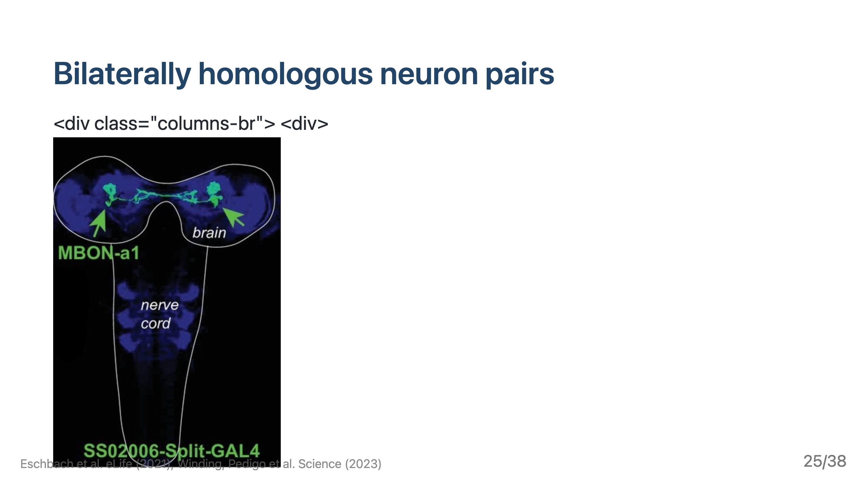

Slide 26
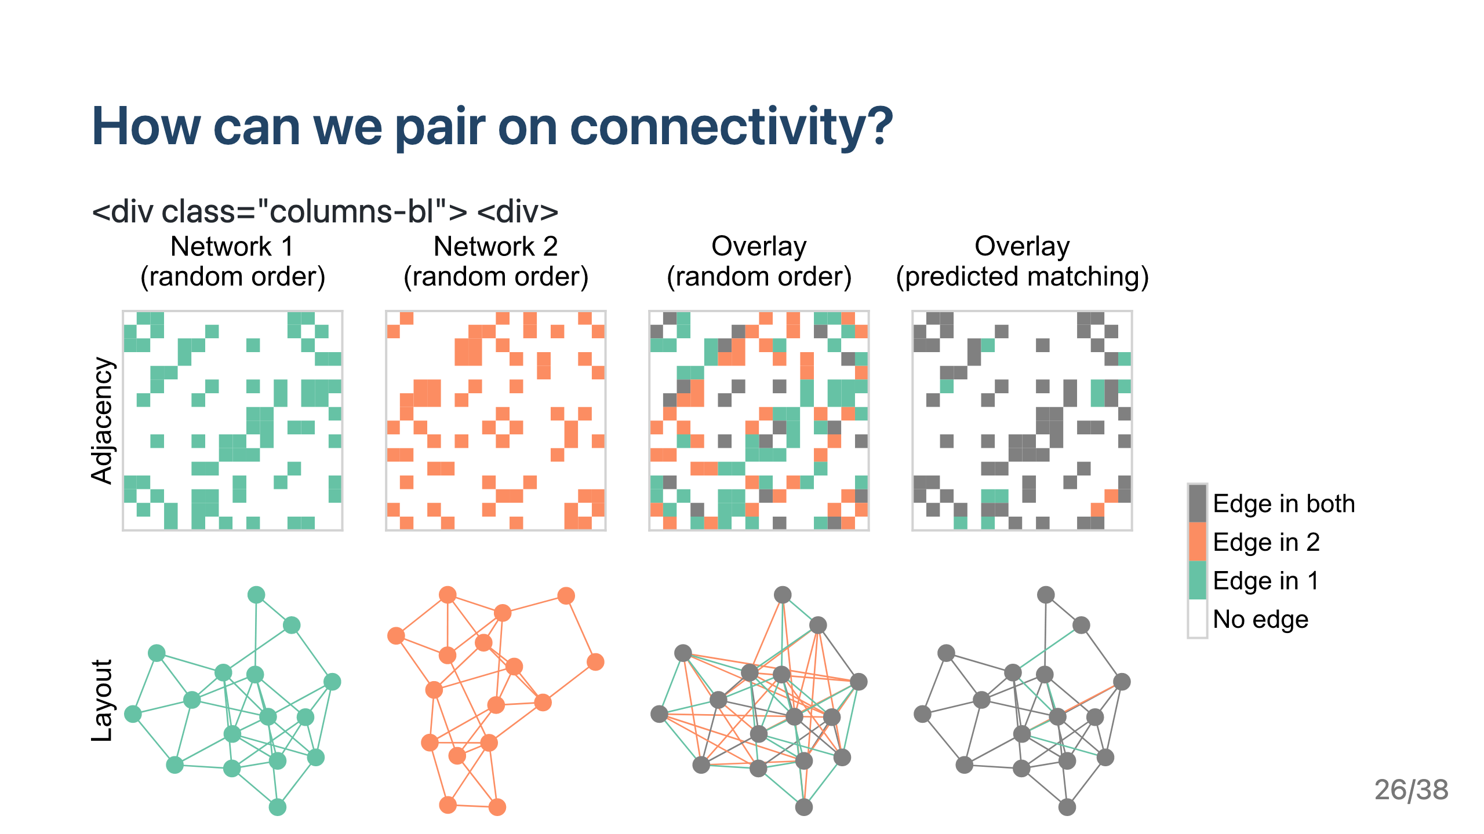

Slide 27
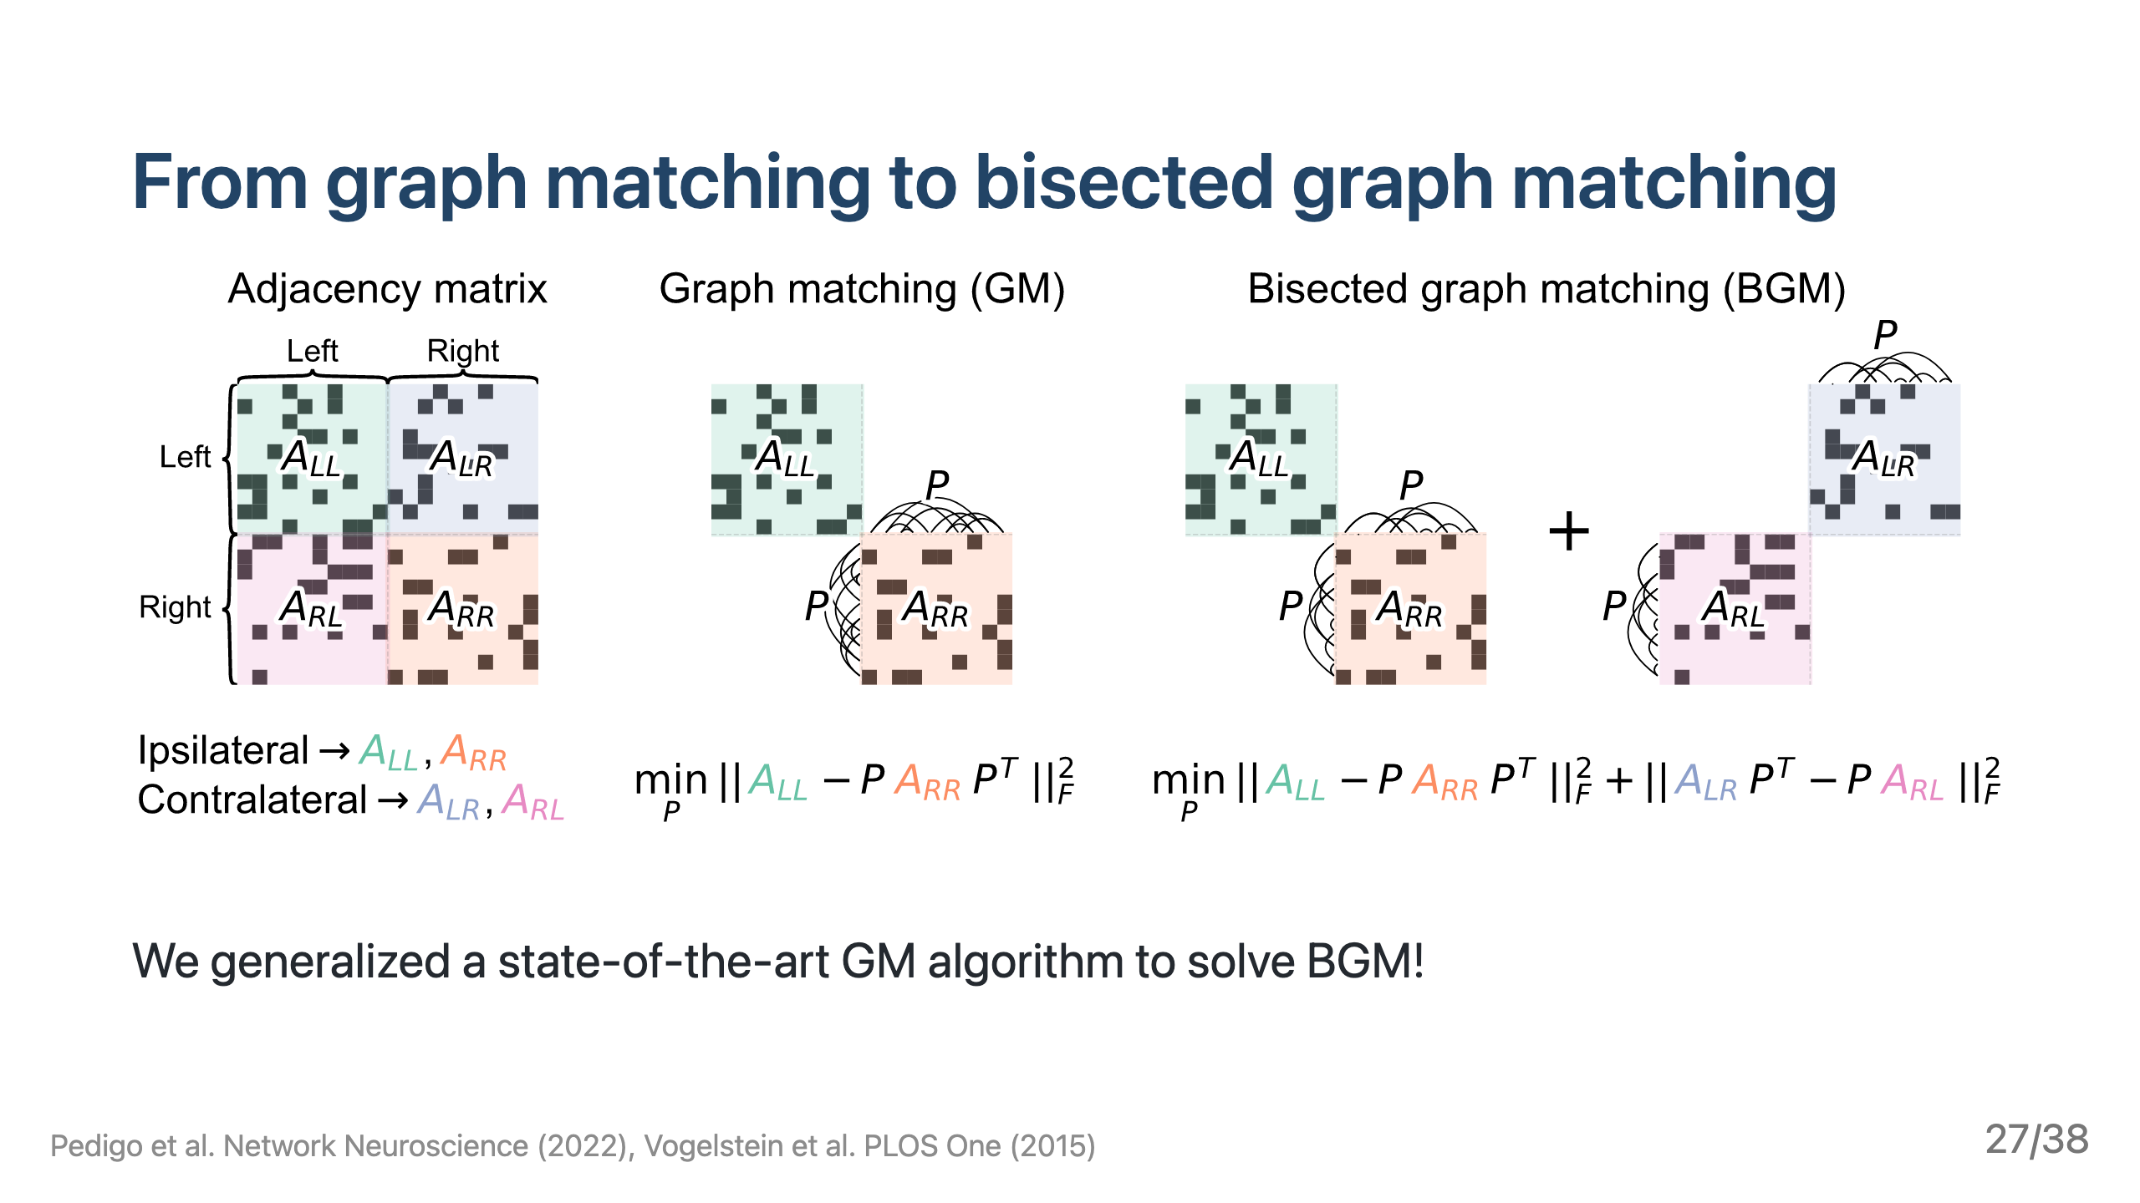

Slide 28
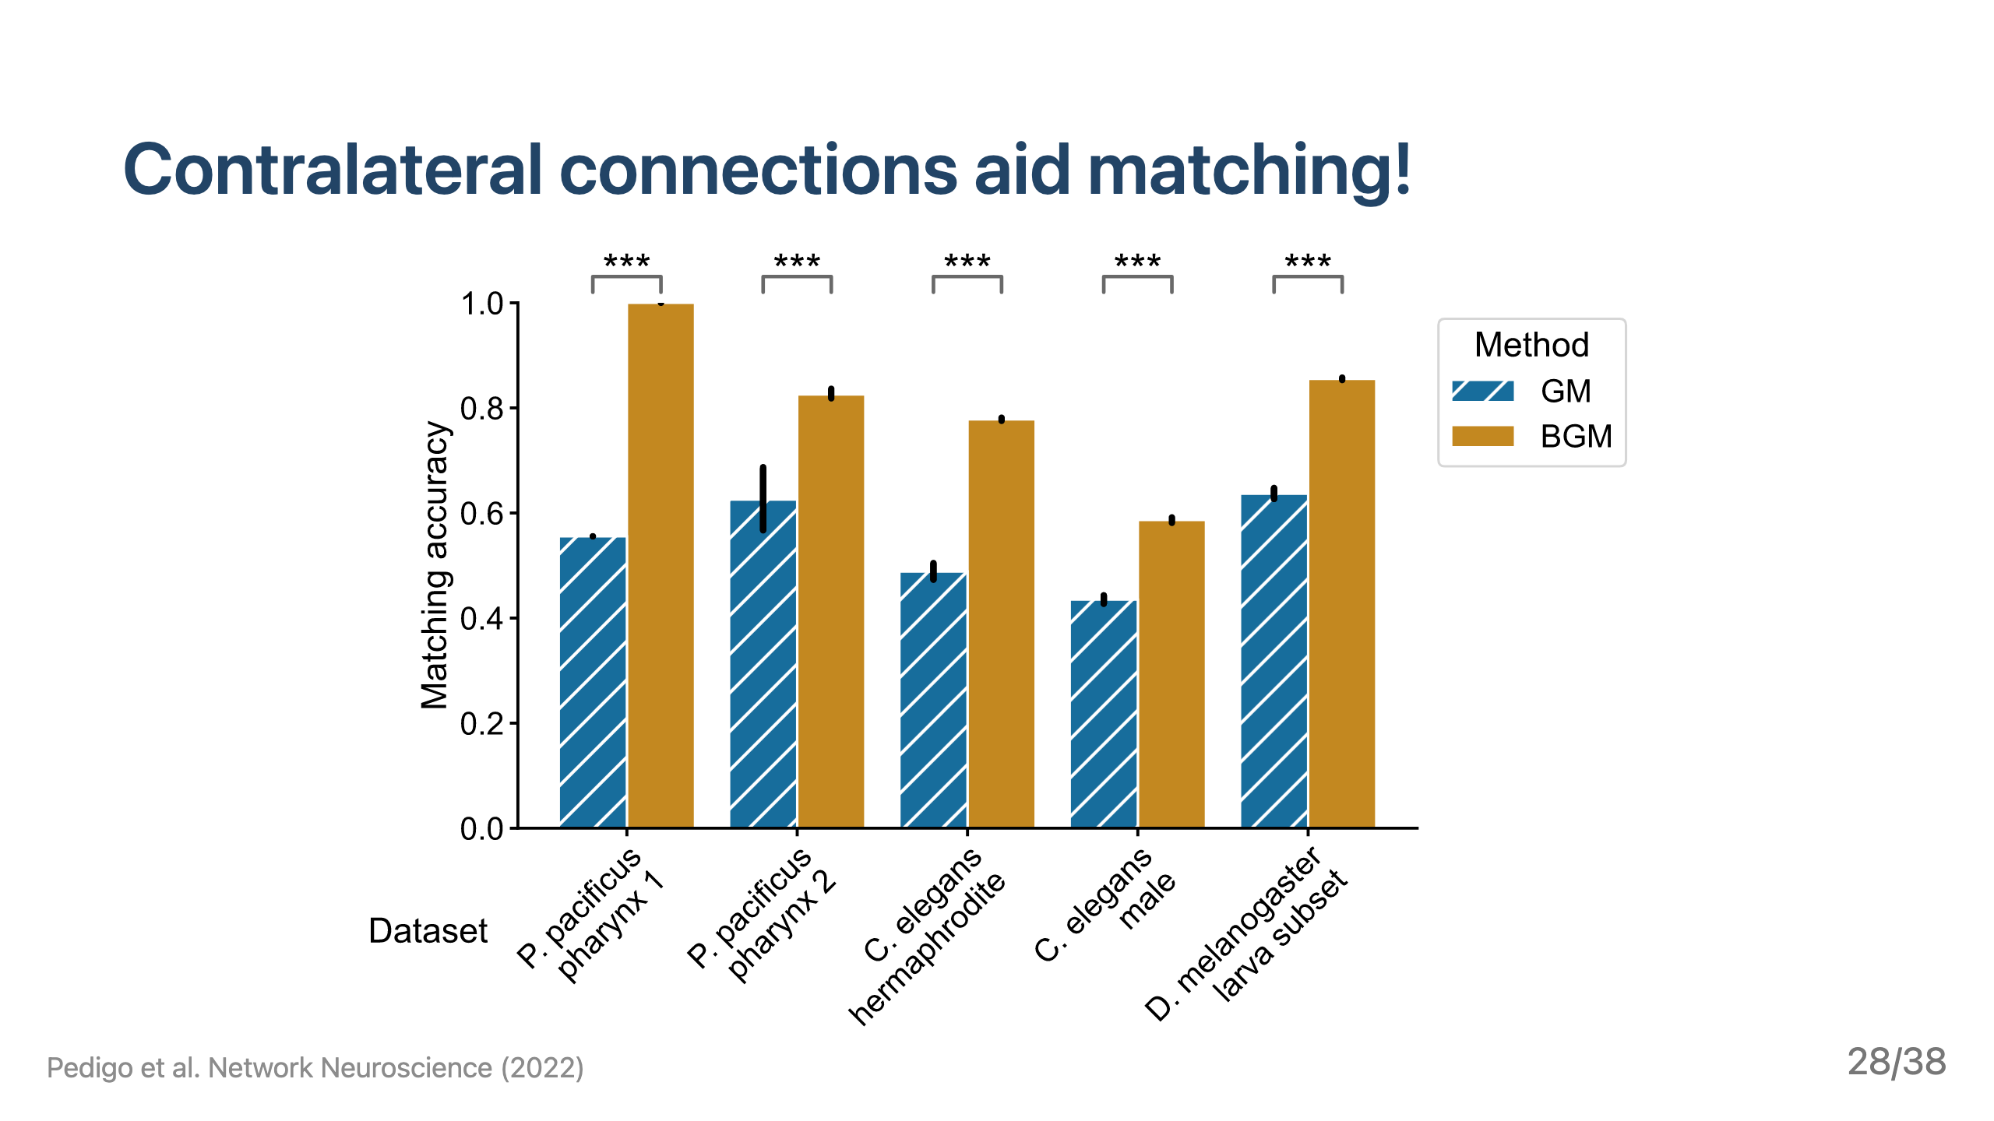

Slide 29
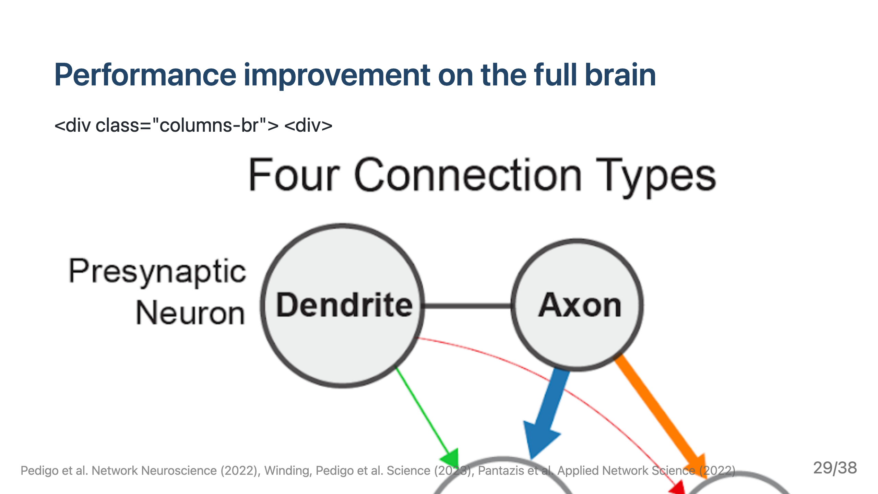

Slide 30


Slide 31
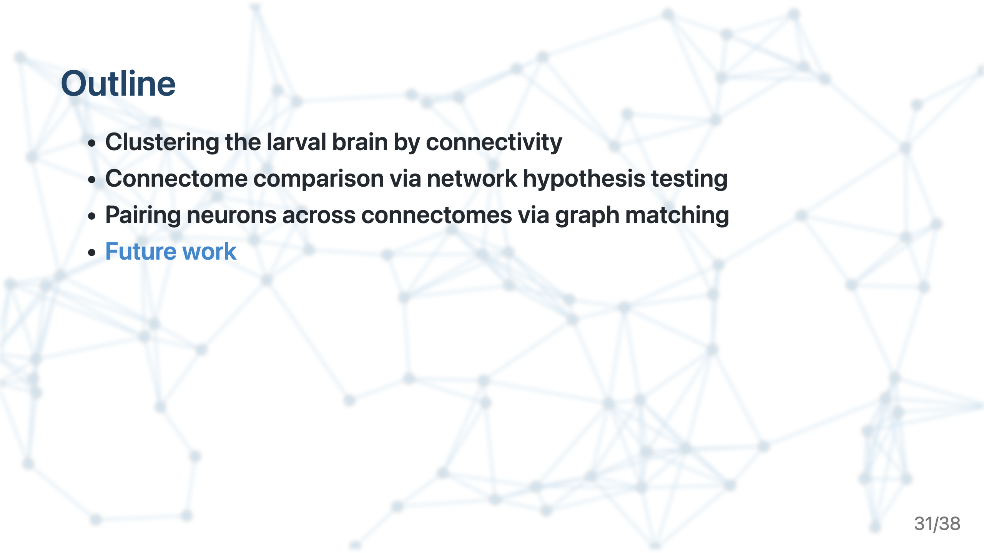

Slide 32
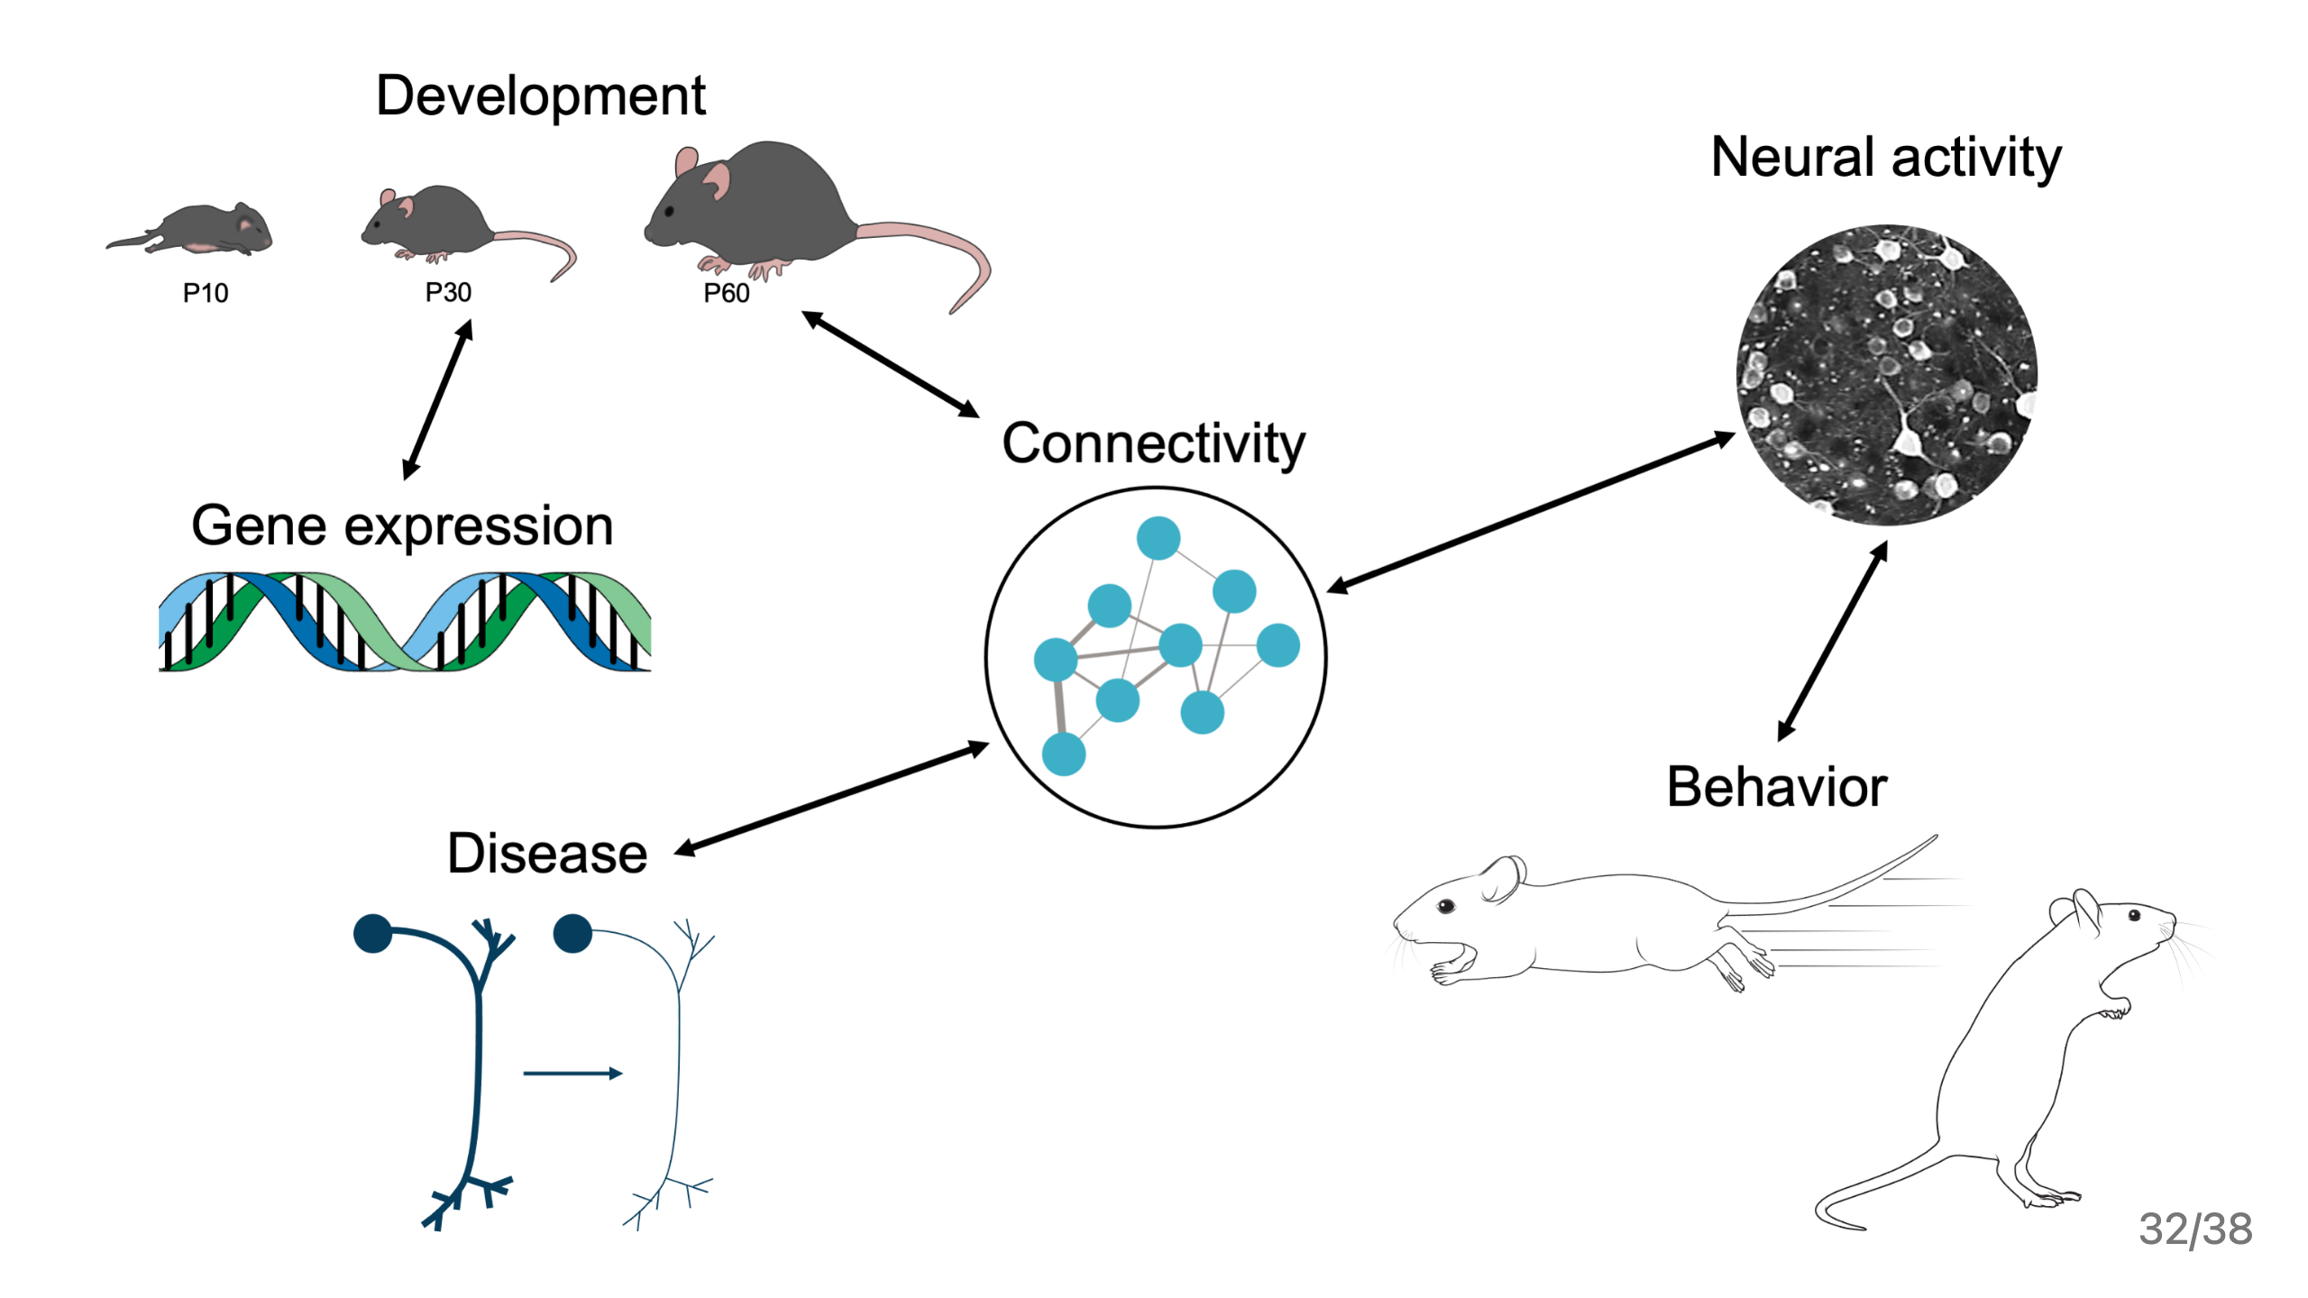
Notes:
As mentioned, interested in leveraging this work on how we can compare connectomes to find links to these various other phenotypes. This is what makes the work being done at the Allen institute and UW so exciting to me; given that you all are not just measuring connectomes, but also many other modalities of data. I’d like to give an example of how I’m approaching this kind of question in the larva, and how I think with some development, these approaches would be relevant to apply to the allen institute data.

Slide 33
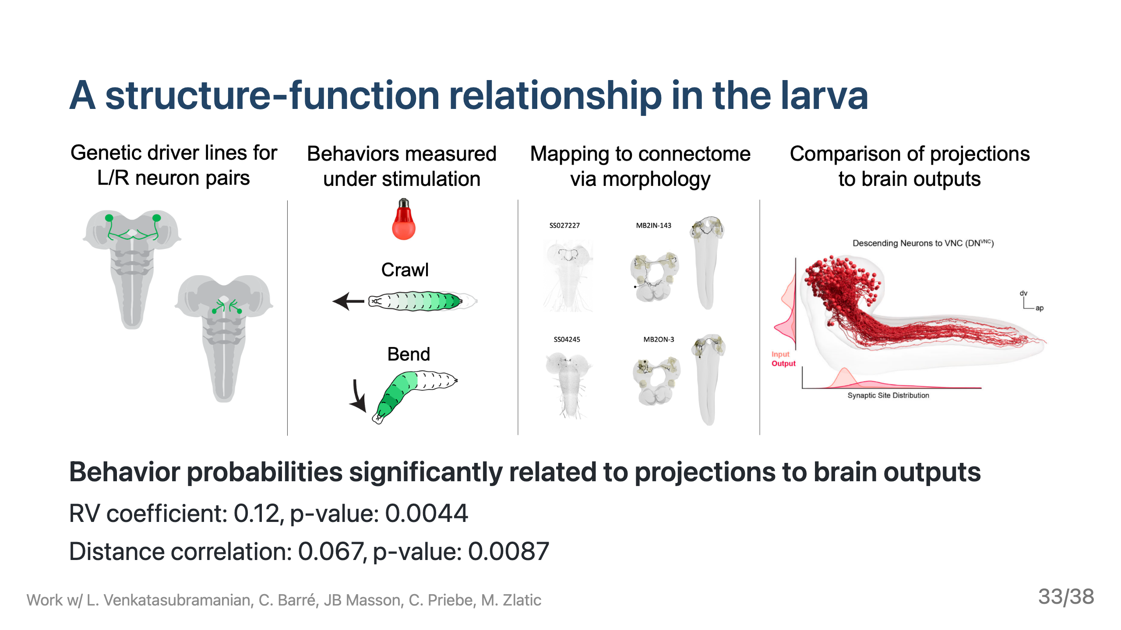
Notes:
Evidence that characterizing variability in connectivity (in this case, specific projections to brain output neurons), can be related to differences in behavioral outputs

Slide 34
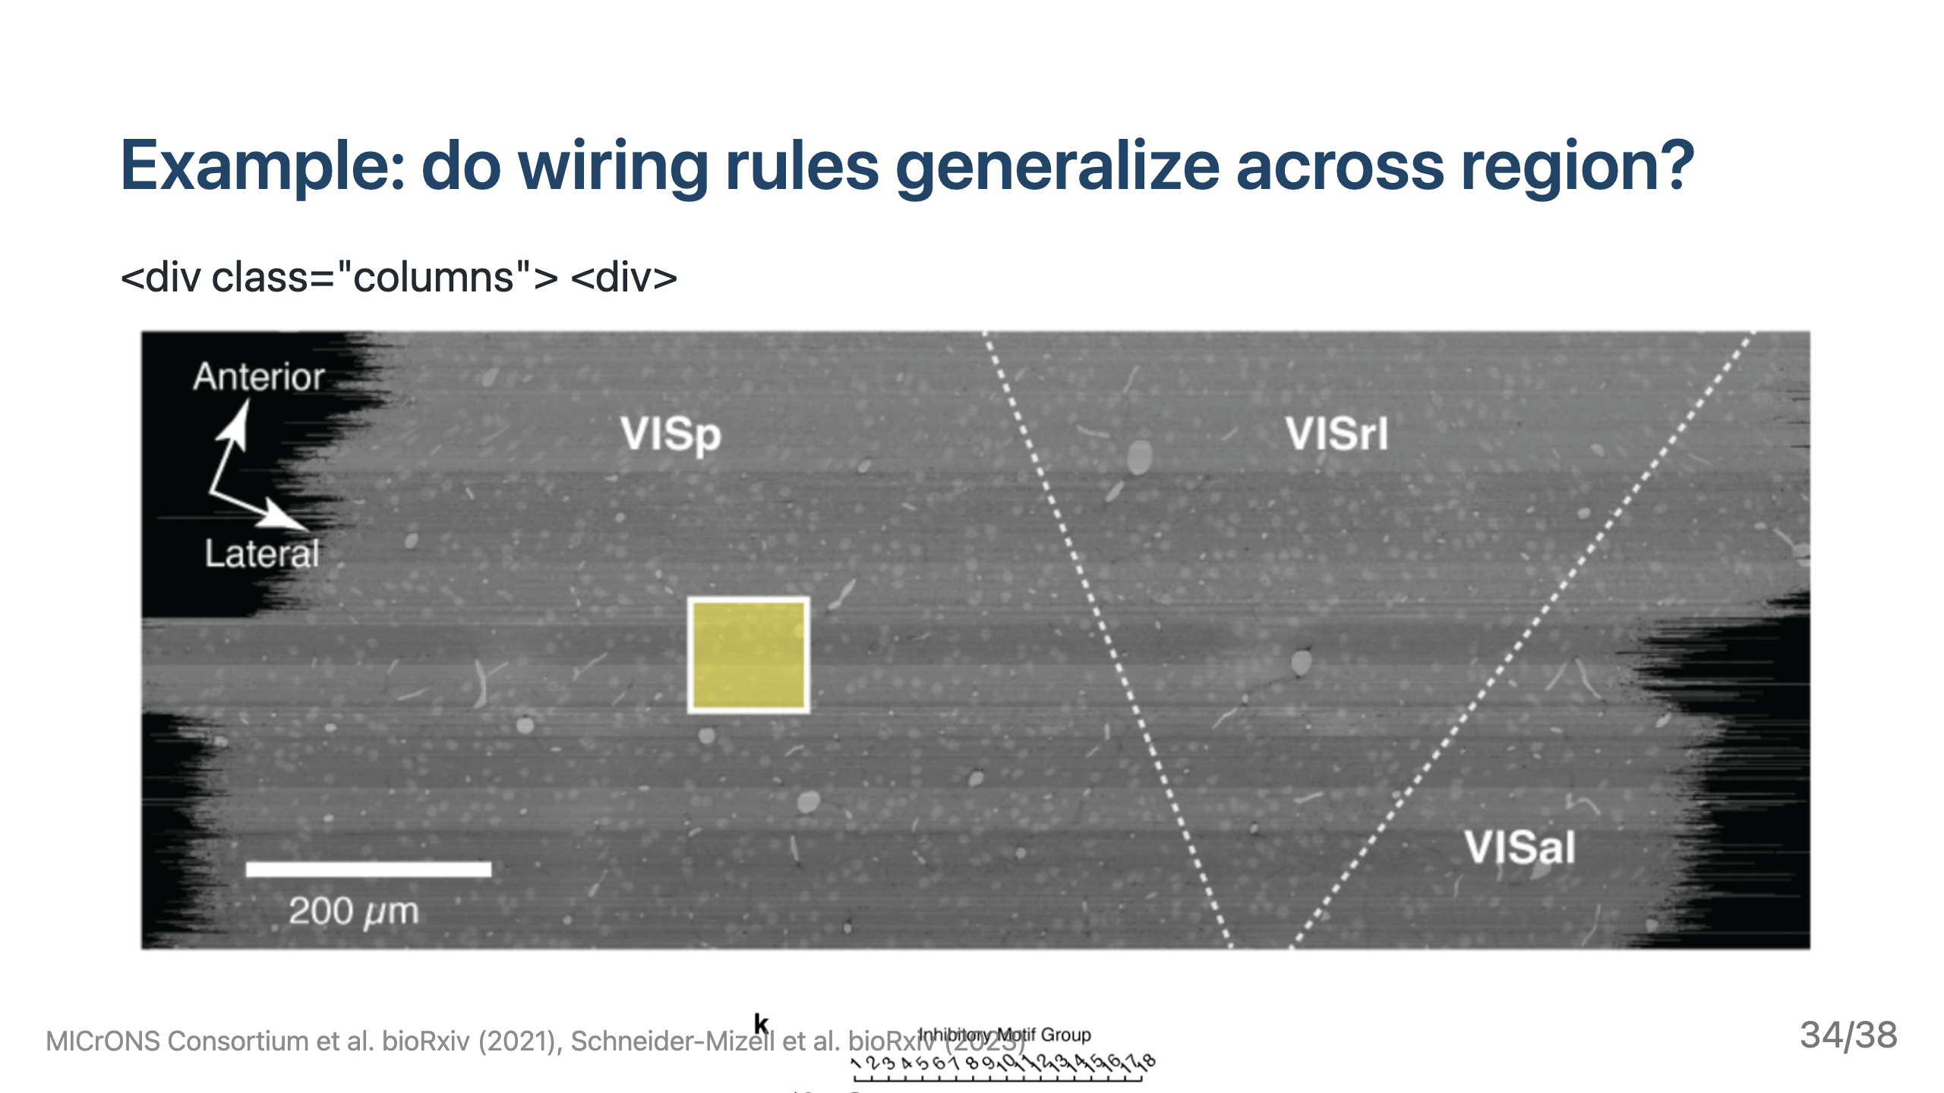
Notes:
As an example of how this kind of approach would be relevant at Allen, take for example the recent work from the microns consortium to map out connections in the visual cortex of a mouse. This dataset is already revealing principles of how cortical circuits are wired, for instance in this recent paper investigating the structure of inhibition onto I am interested in using our network testing methods to see whether these rules hold, say, for other subvolumes in the same region of visual cortex, and in particular, whether they are different in another visual region. This would be a natural application of my work on model-based comparison of neural wiring rules. Methodologically, answering these questions would likely involve incorporating more biological detail into these model-based descriptions of connectivity, for instance incorporating wiring rules based on space and sub-cellular compartments. I’d be excited to work with both allen institute and UW researchers on these kinds of extensions. ![h:350](https://raw.githubusercontent.com/bdpedigo/talks/main/docs/images/microns-volume.png)

Slide 35
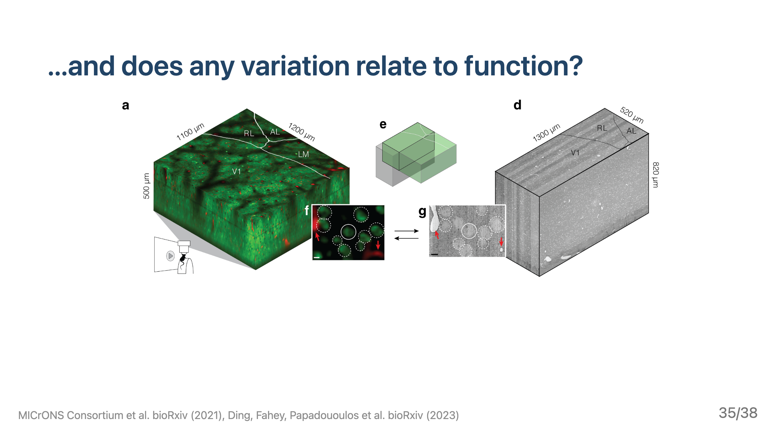
Notes:
Finally, as I’ve mentioned, i think the reason to do all this careful study of wiring rules is ultimately to see how this impacts function, which is part of what makes me fascinated by the microns data, where neural activity was also characterized for many neurons. I’m interested in trying to connect any variation we see in neural wiring rules to variation in aspects of neural activity, using some of the tools i mentioned for high dimensional independence testing in our work on the larva.

Slide 36
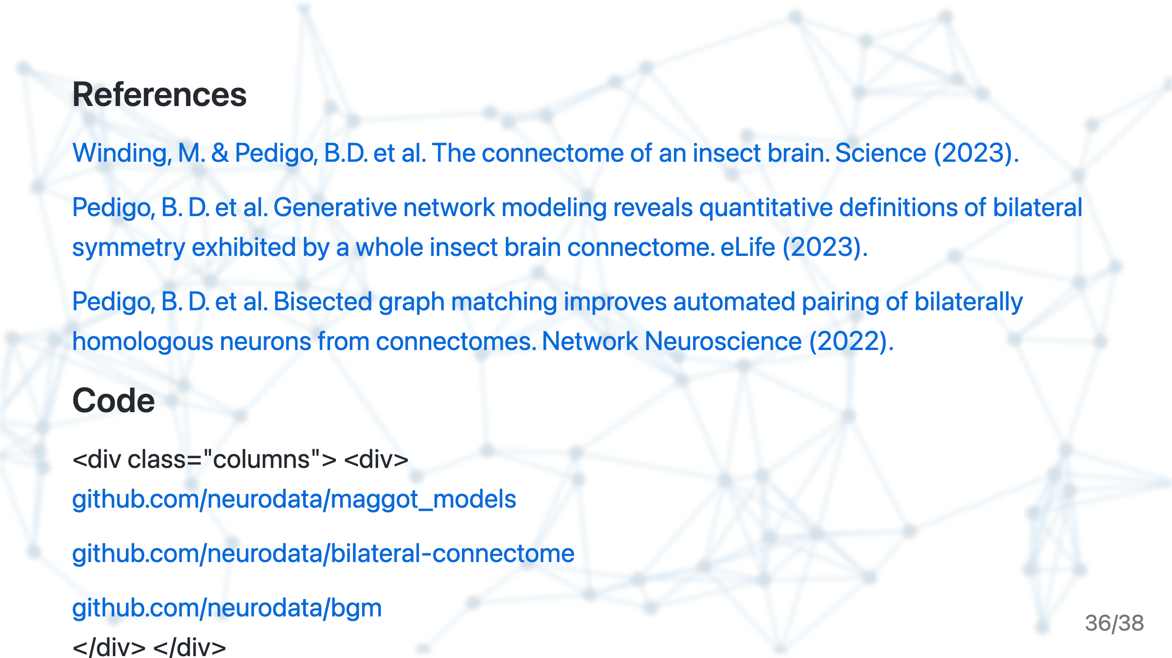

Slide 37
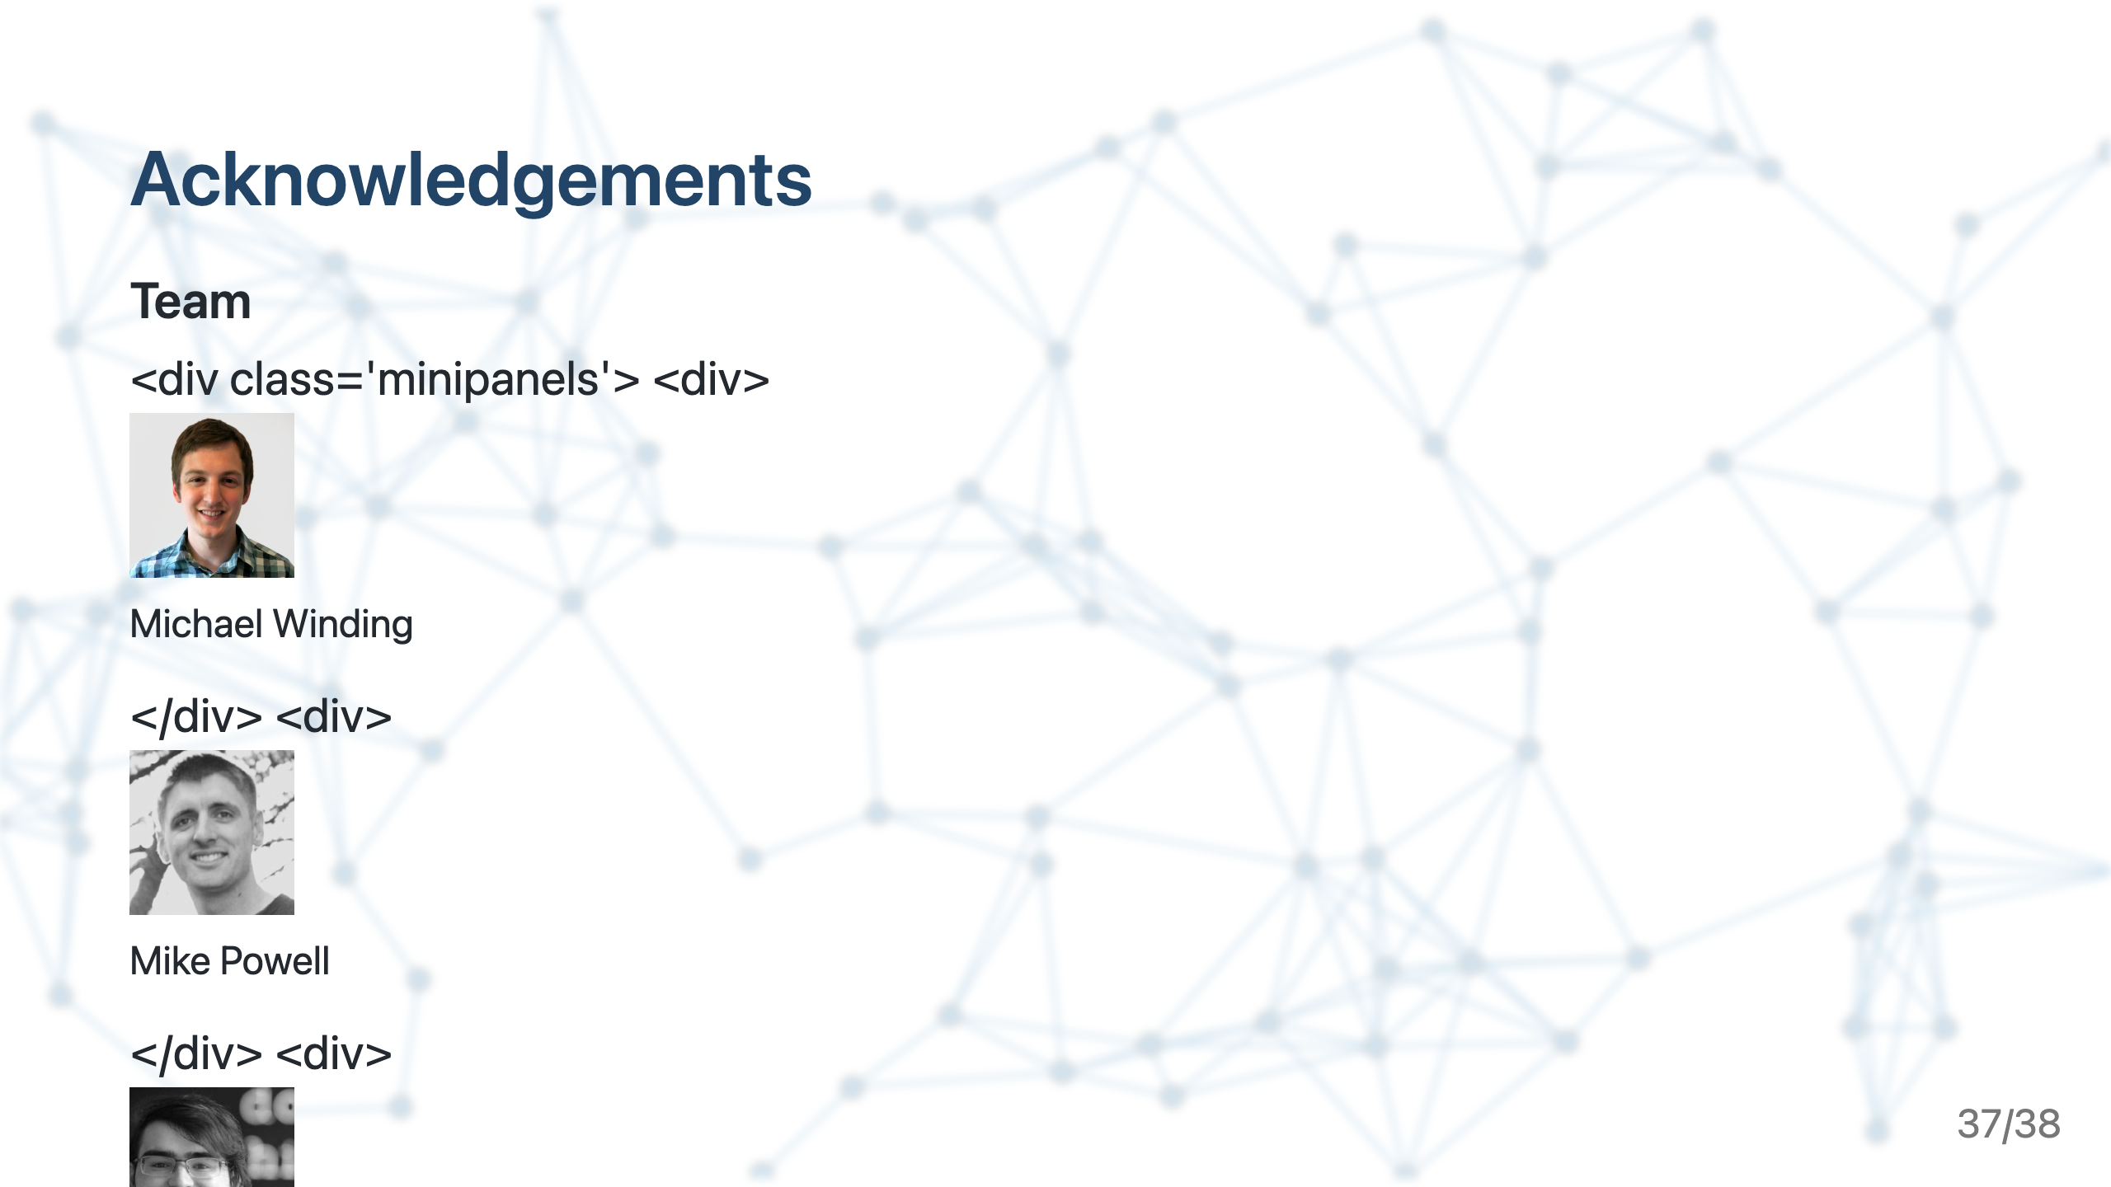

Slide 38
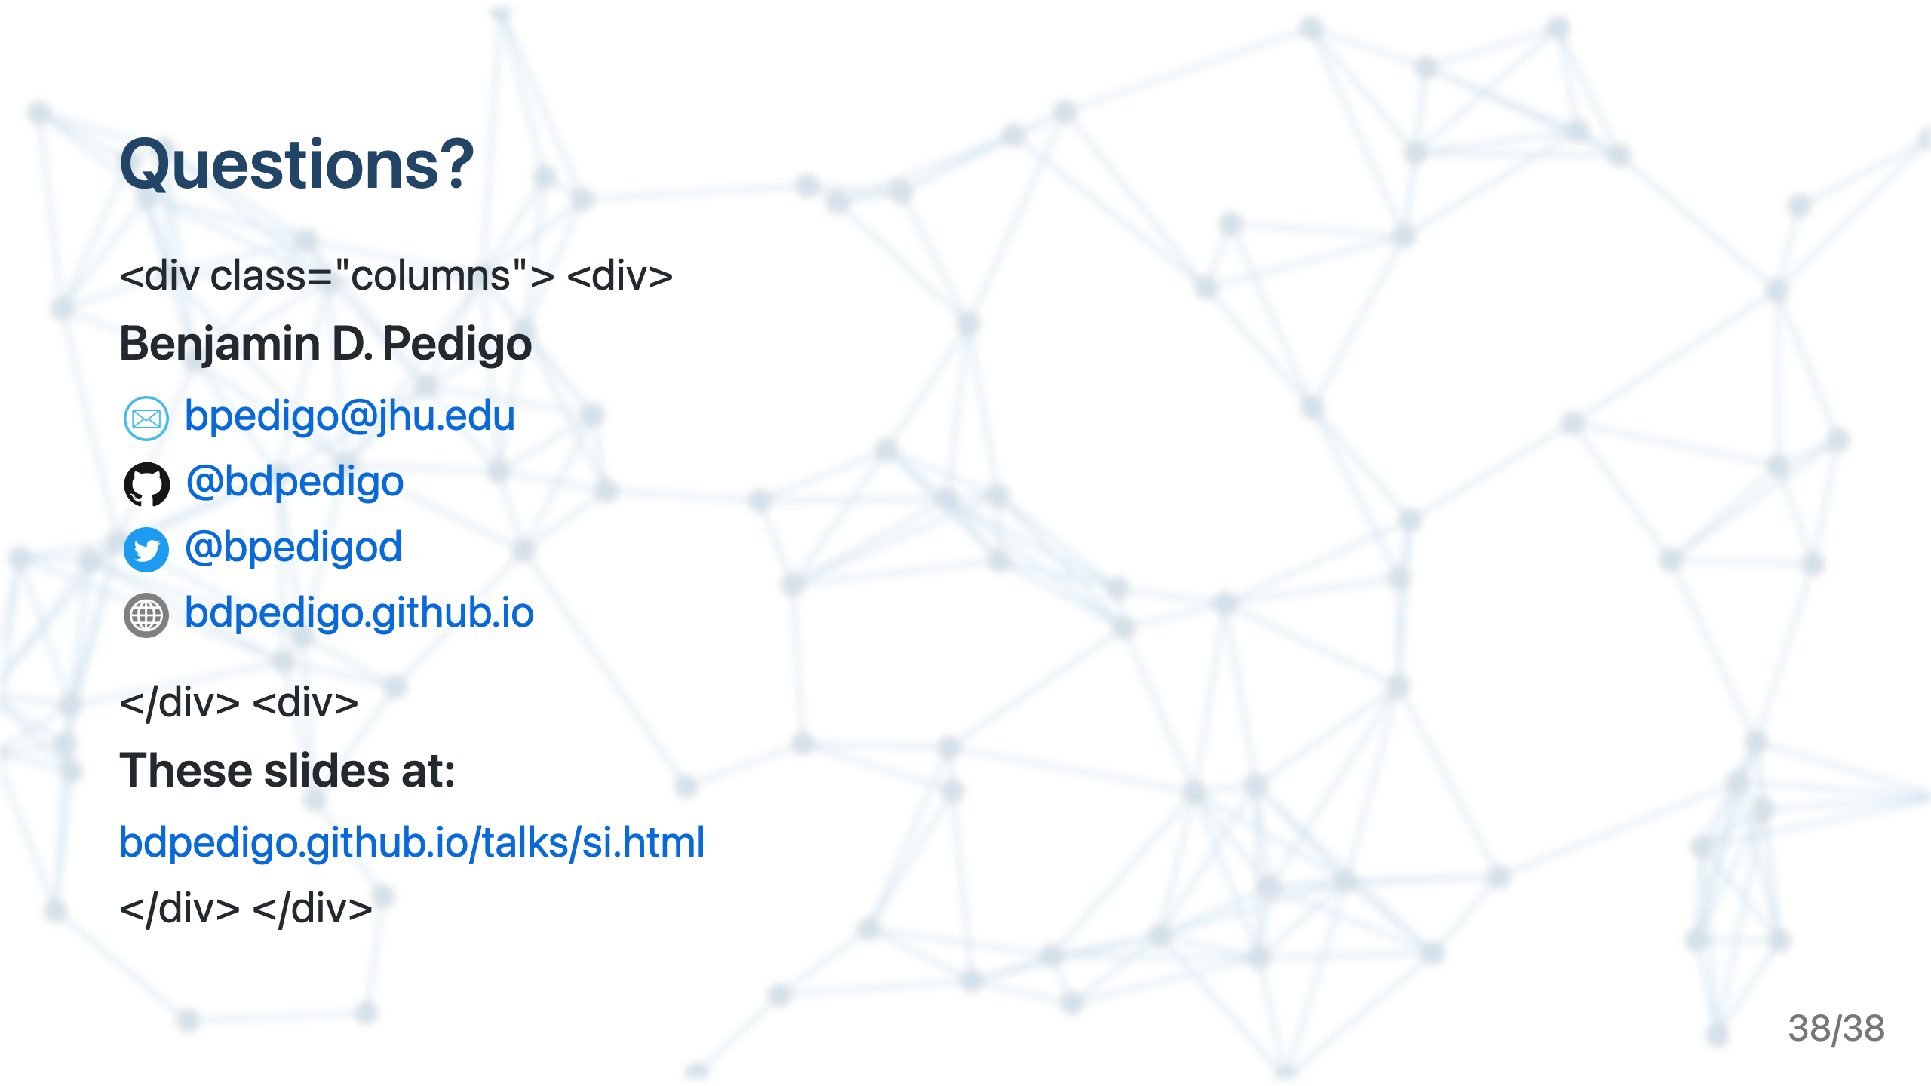

Slide 39


Slide 40
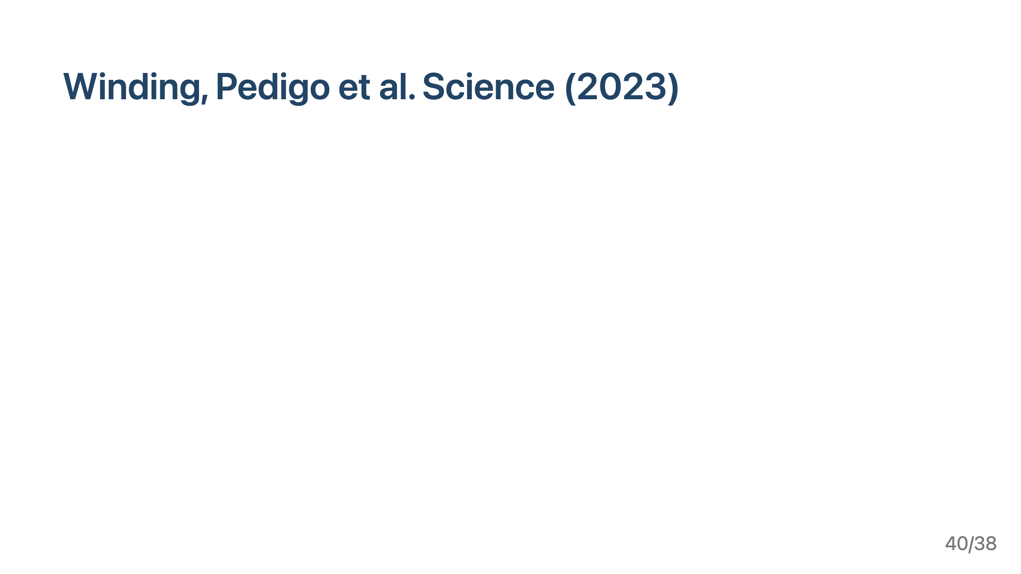

Slide 41
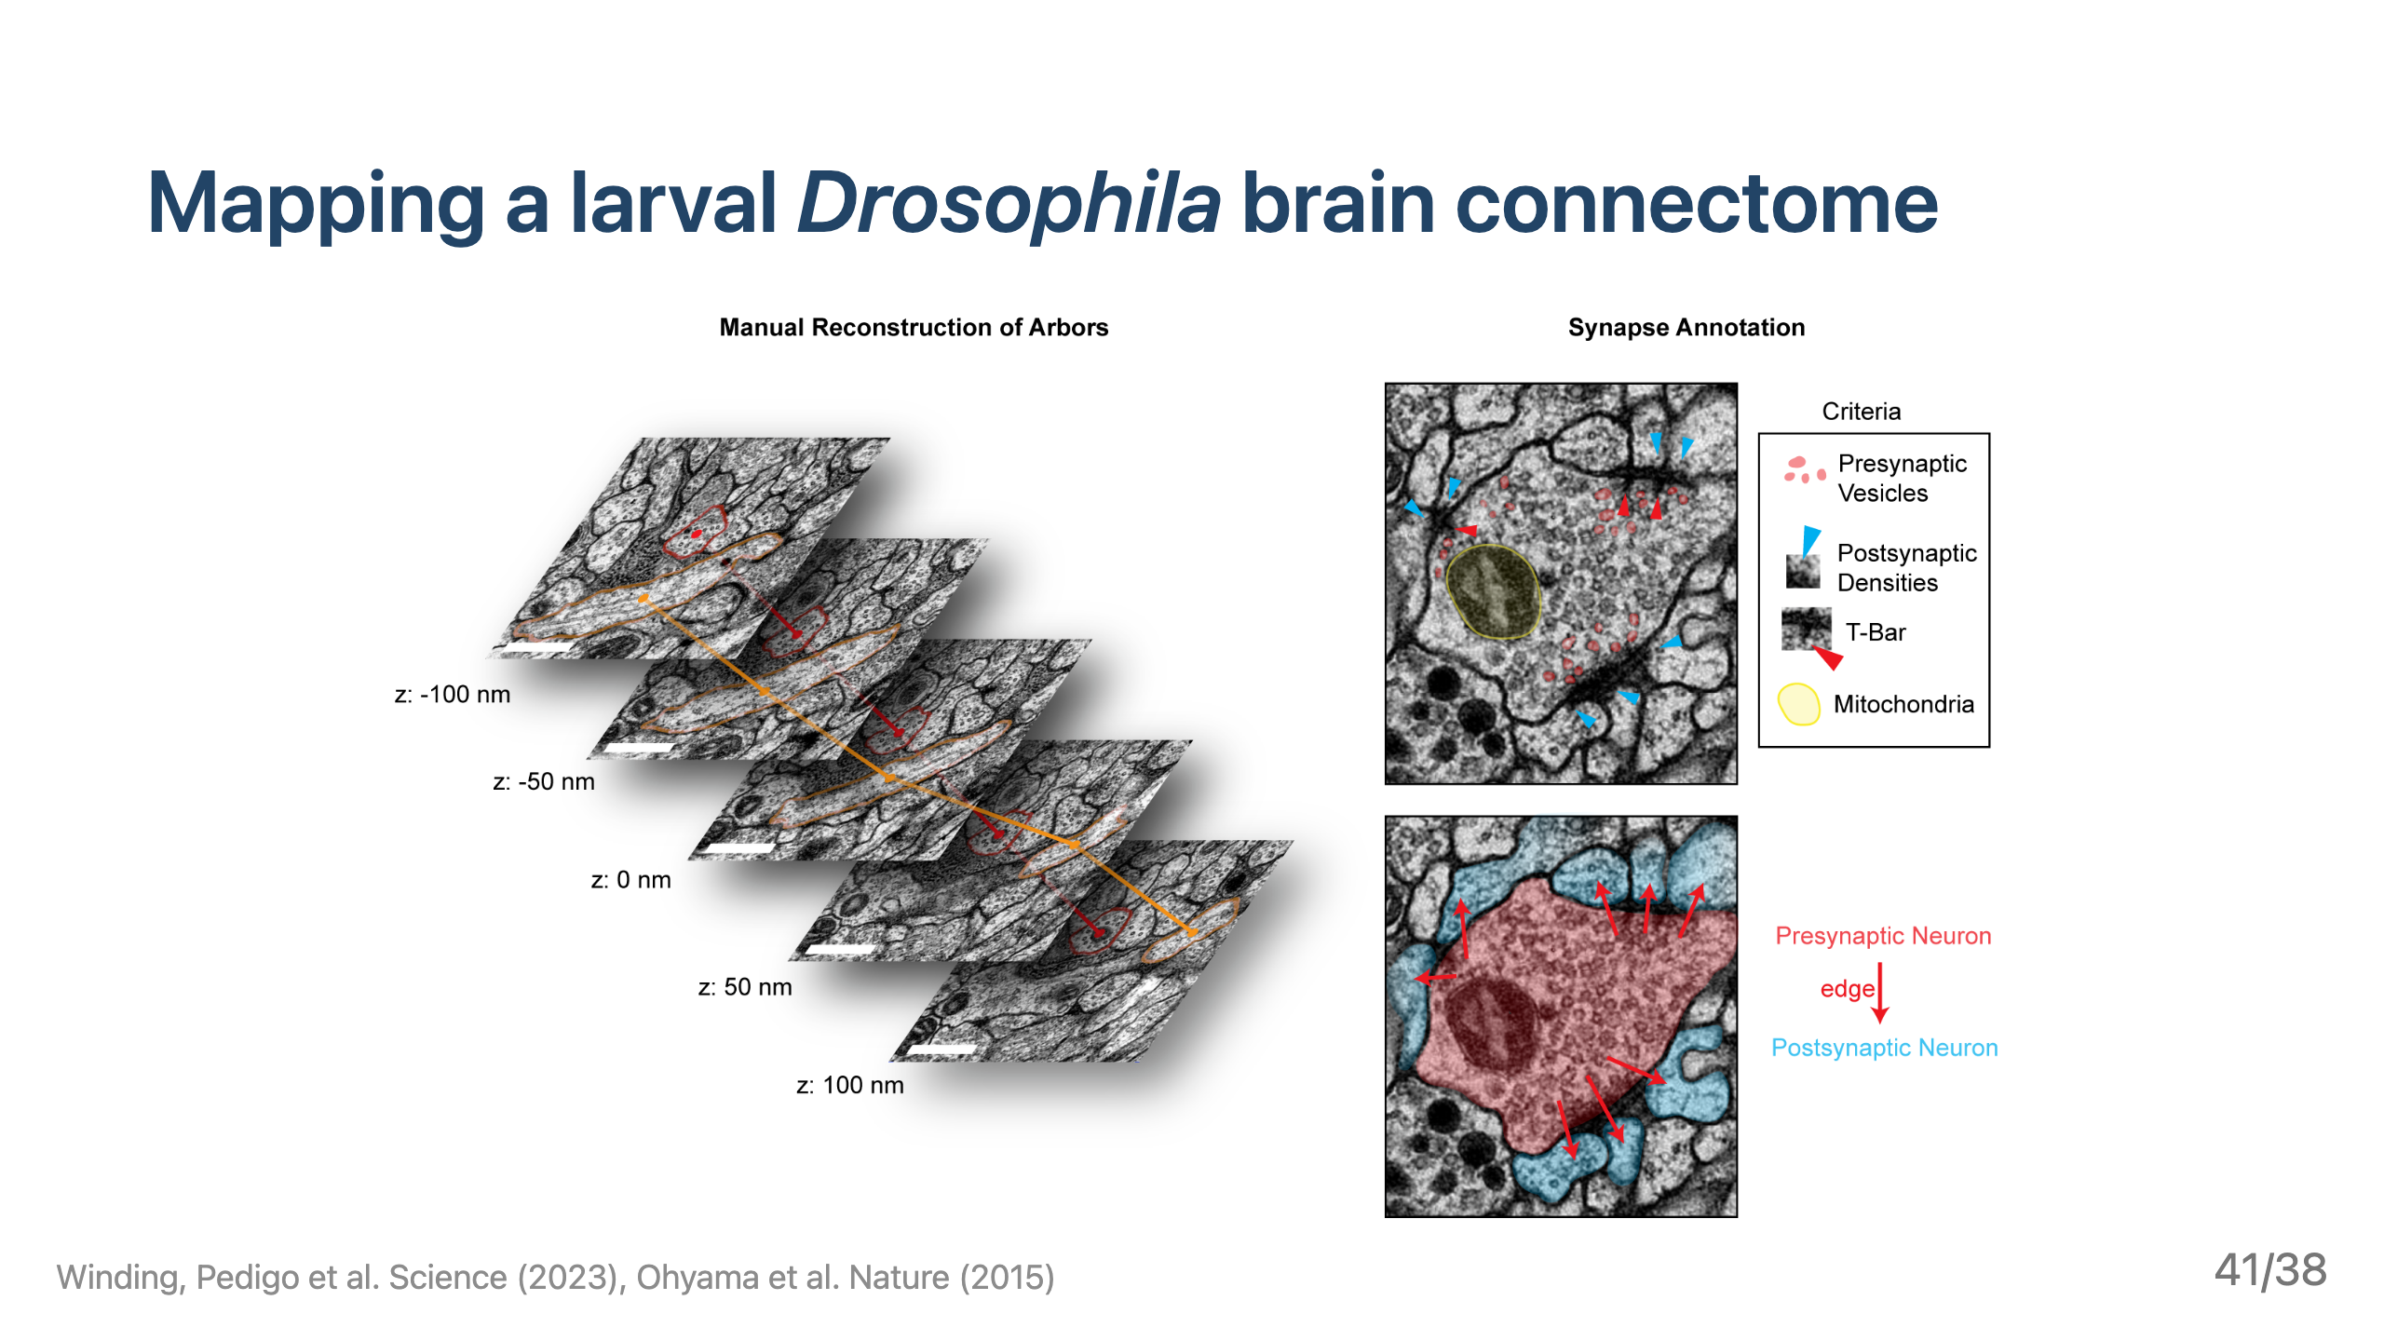

Slide 42
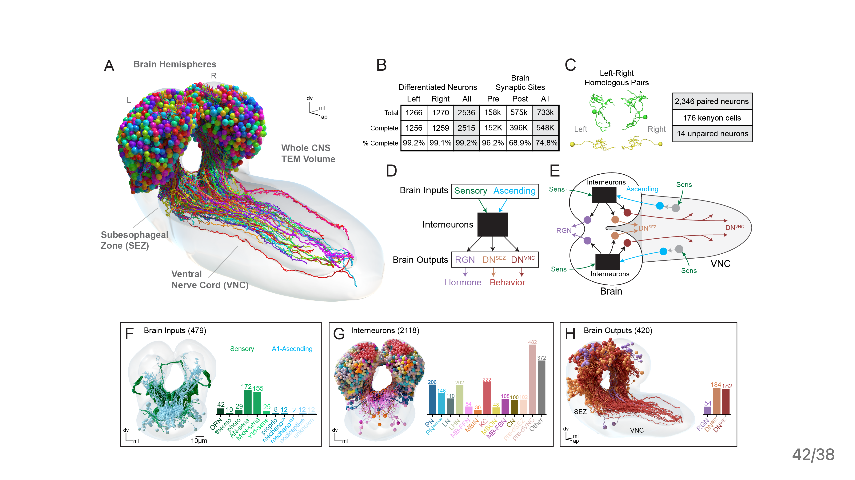

Slide 43
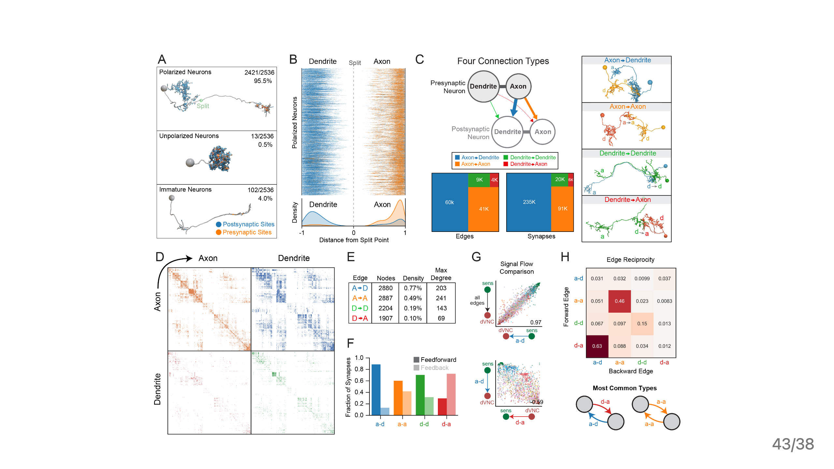

Slide 44
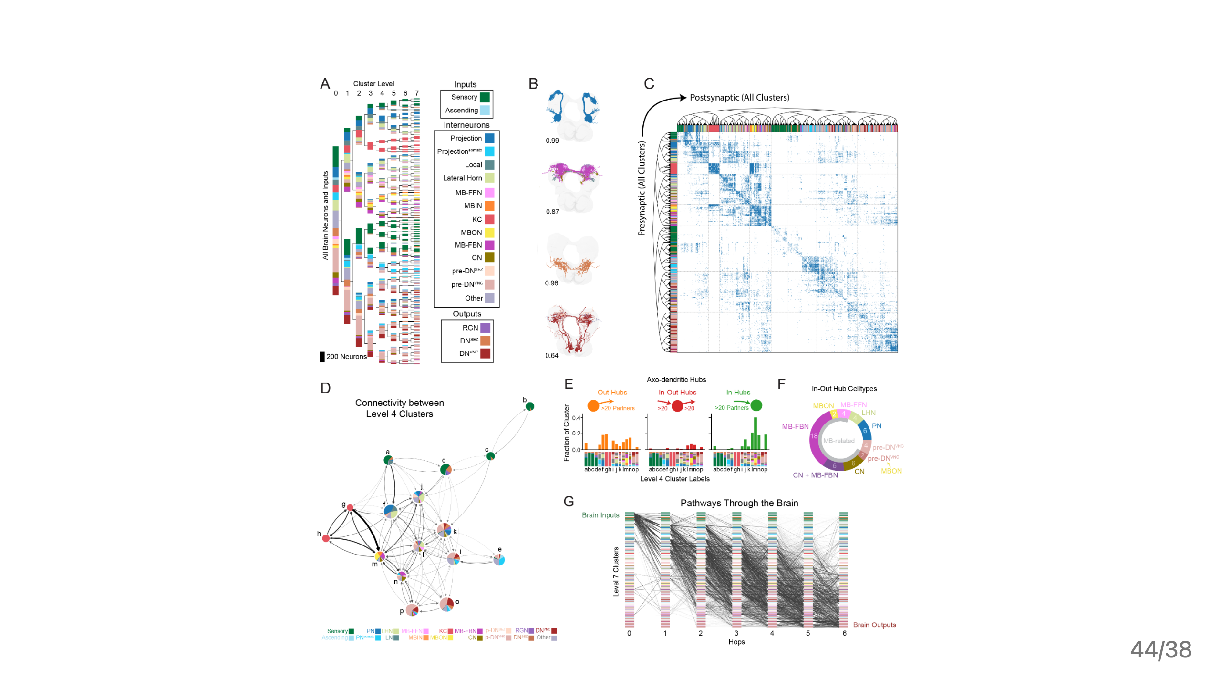

Slide 45
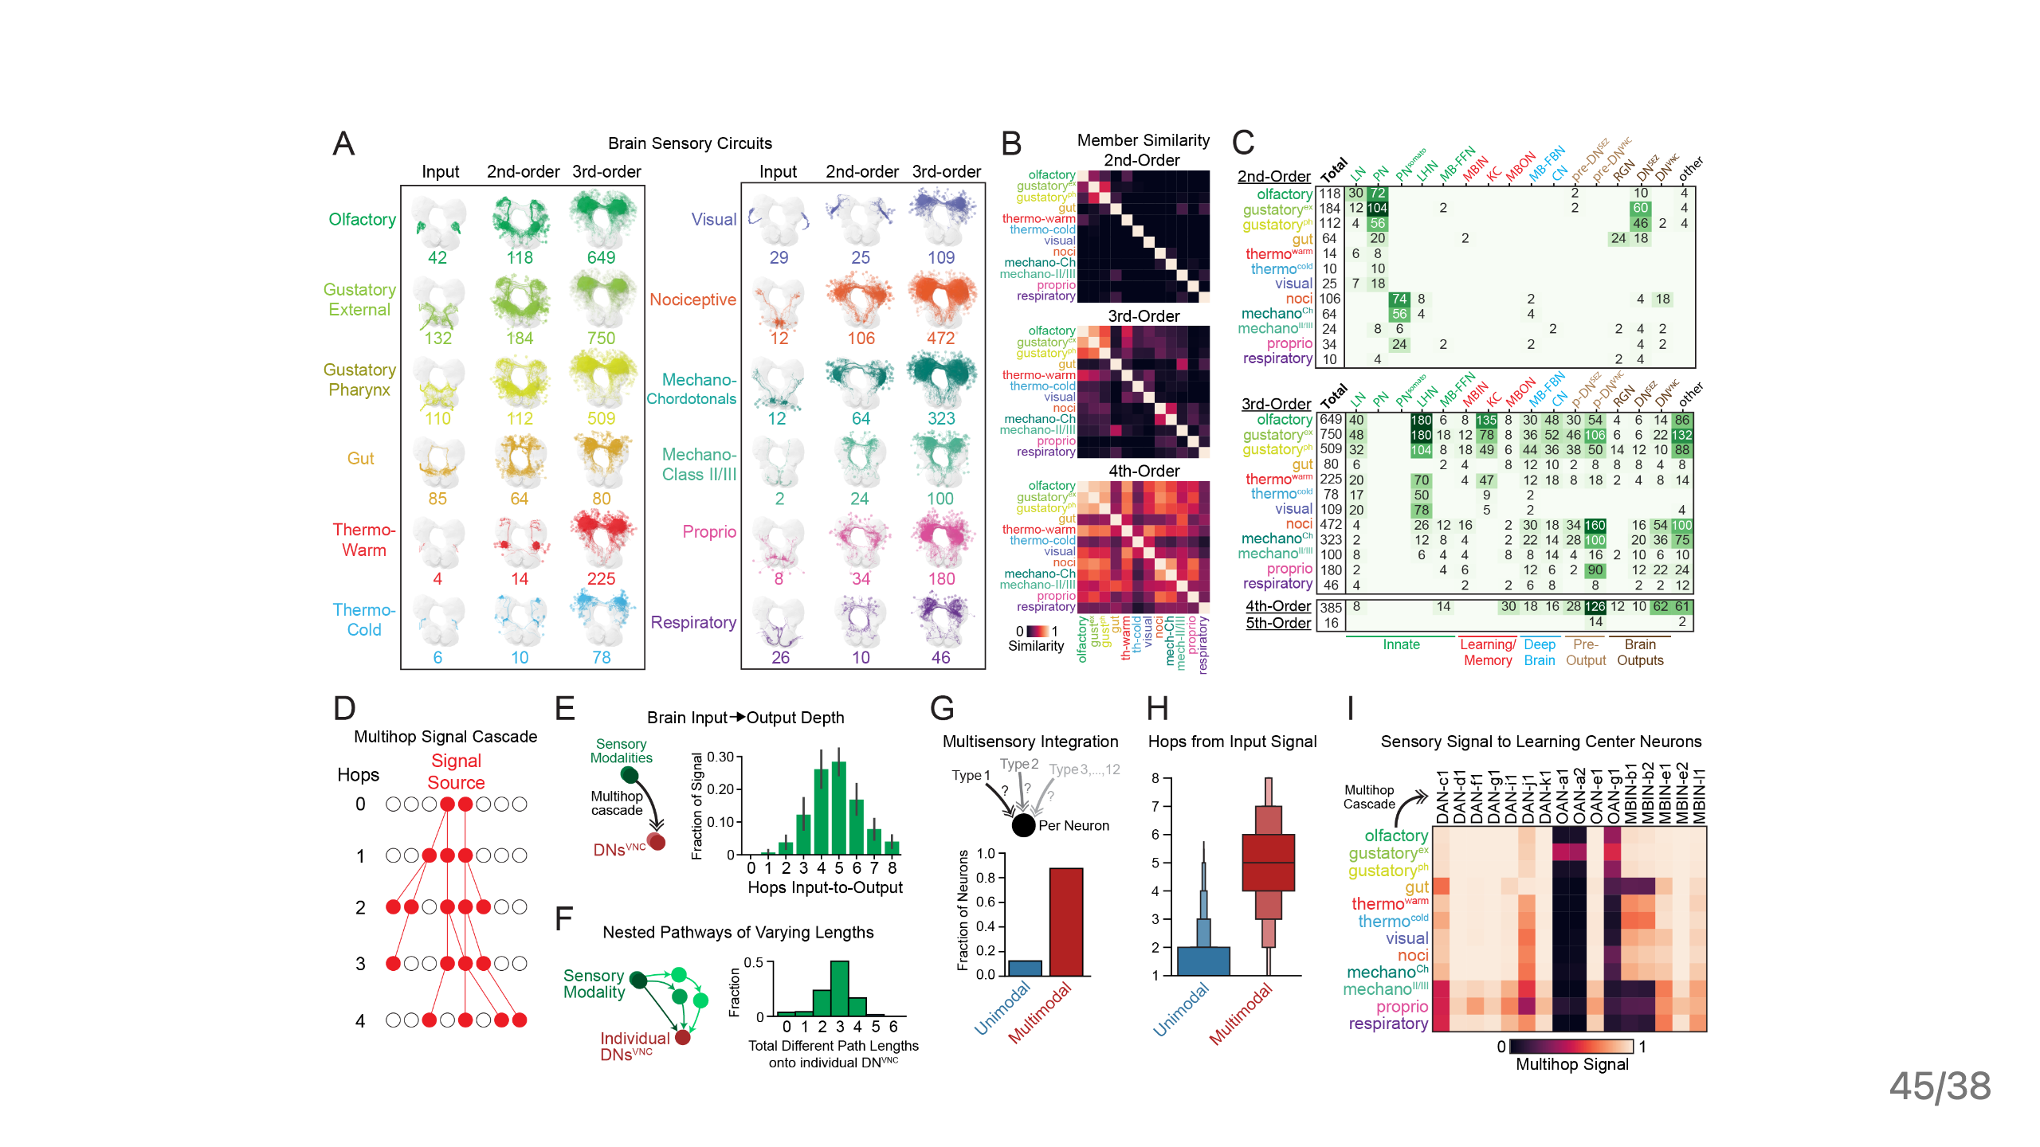

Slide 46
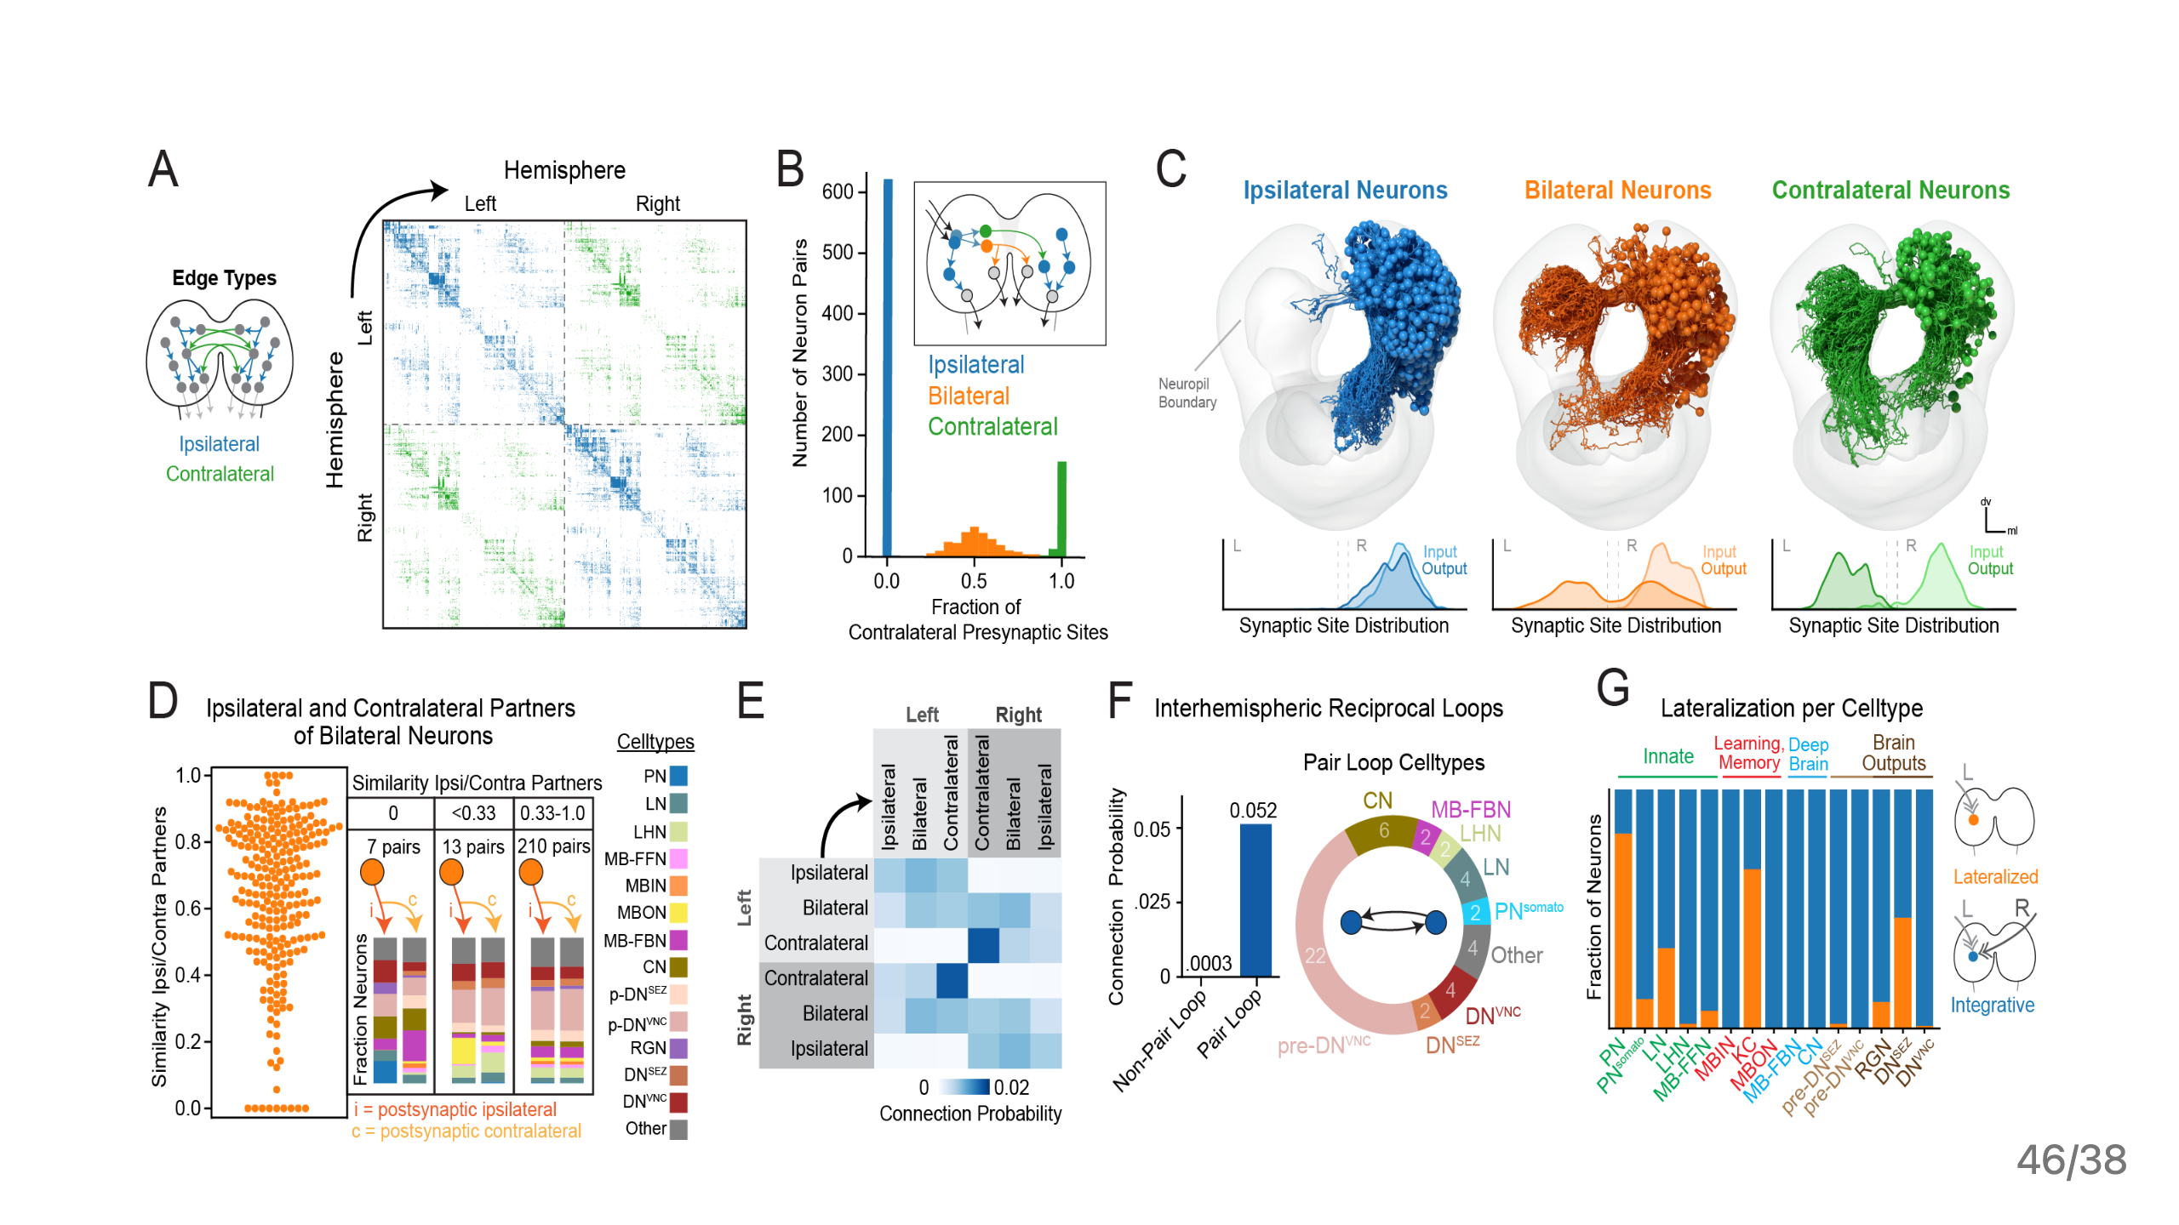

Slide 47
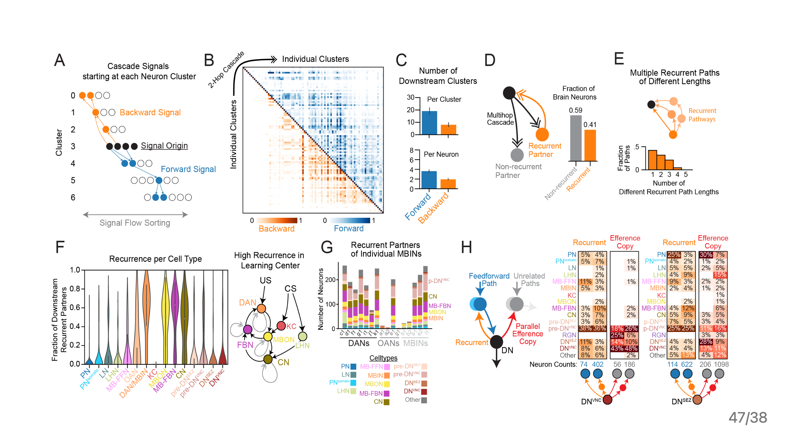

Slide 48
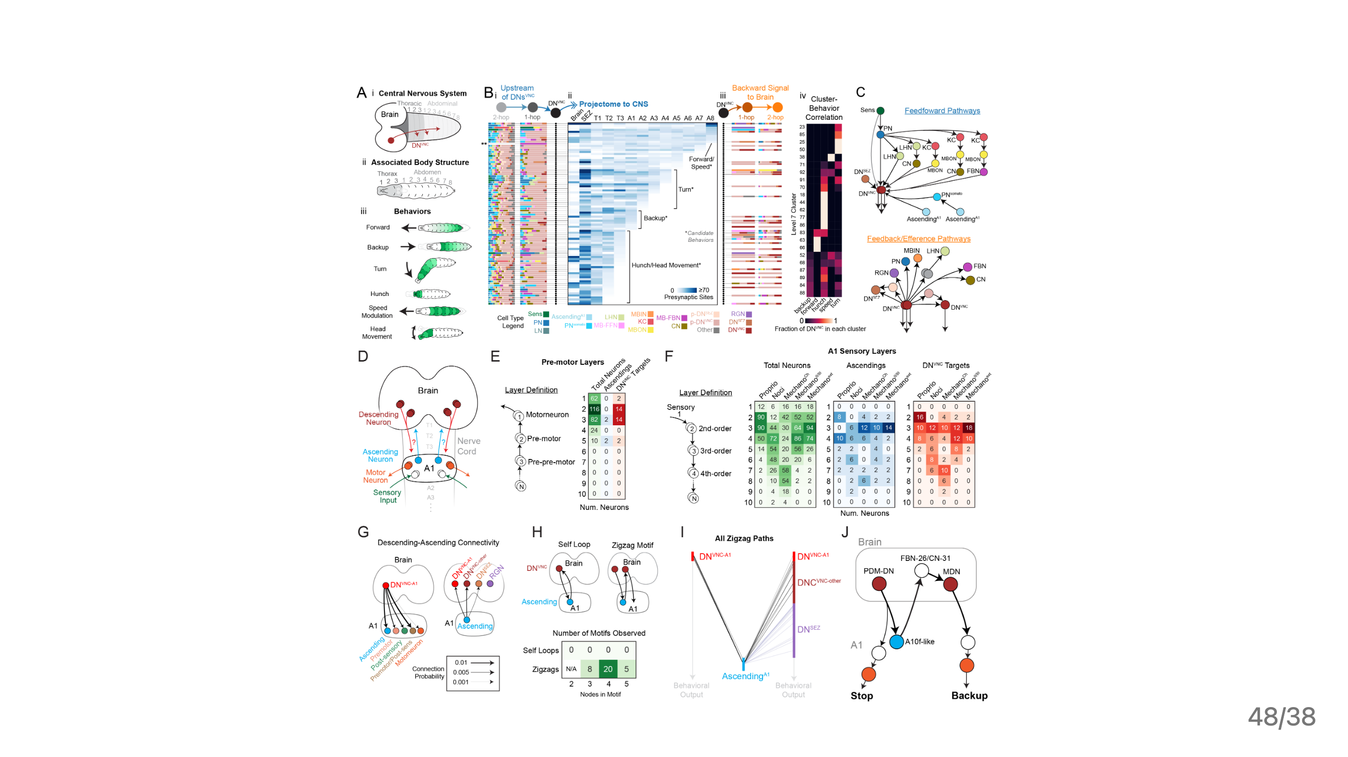

Slide 49
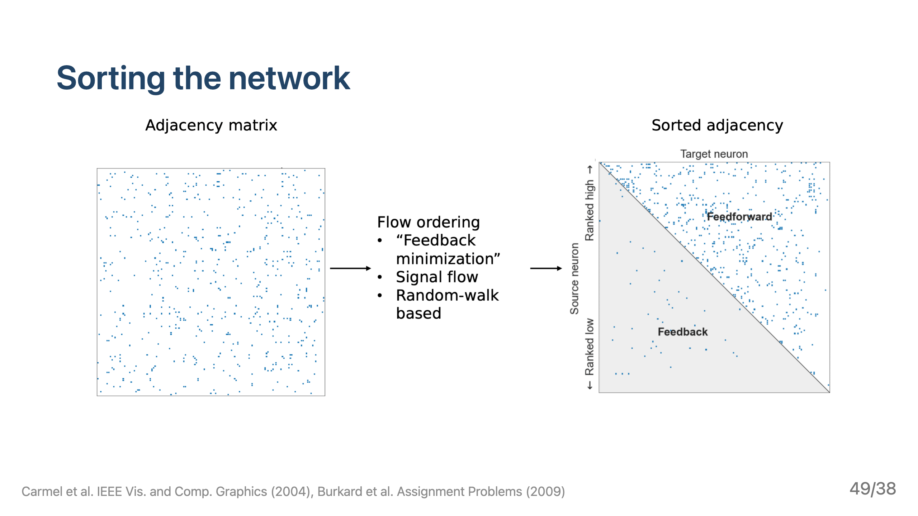

Slide 50
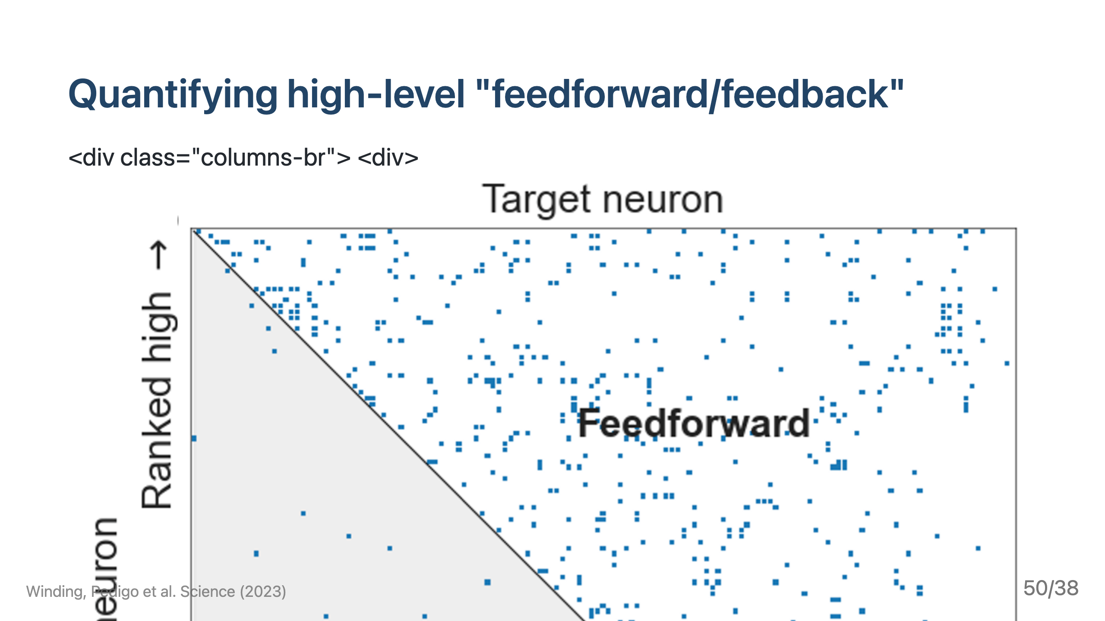
Notes:
![h:300 center](./../../images/fig2f.png)

Slide 51
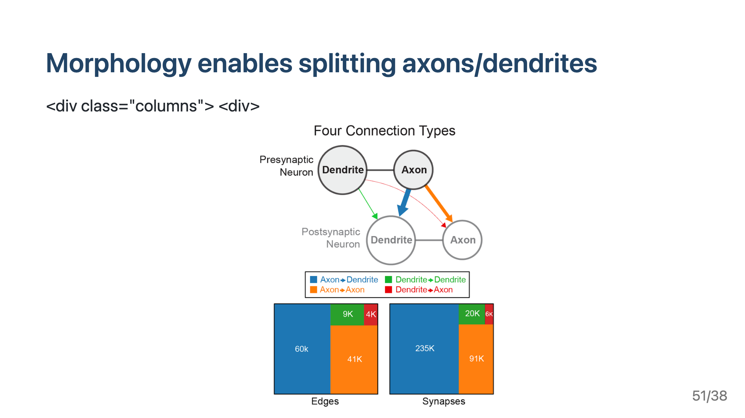
Notes:
![h:500 center](../../images/fig2a.png)

Slide 52
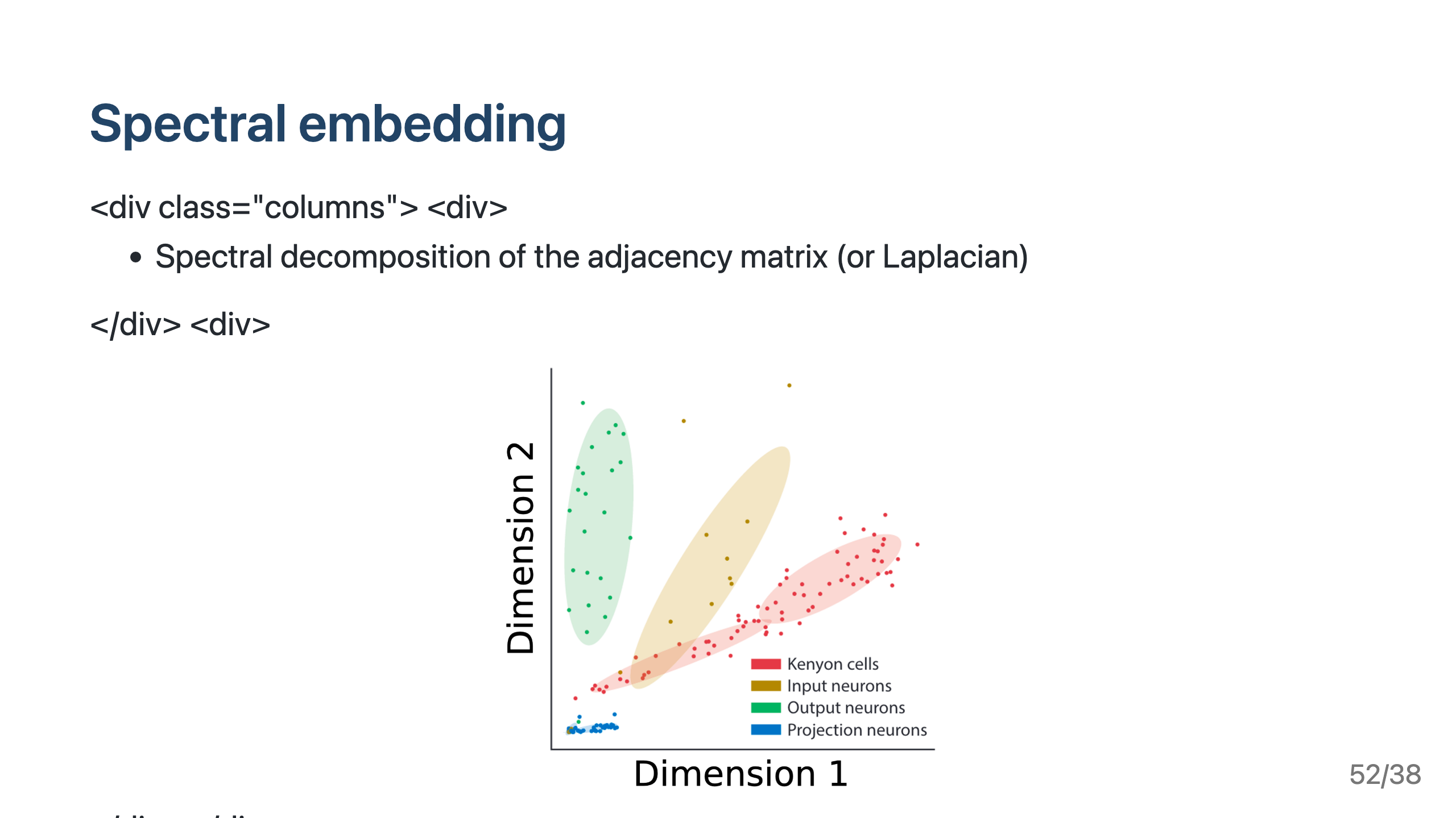

Slide 53
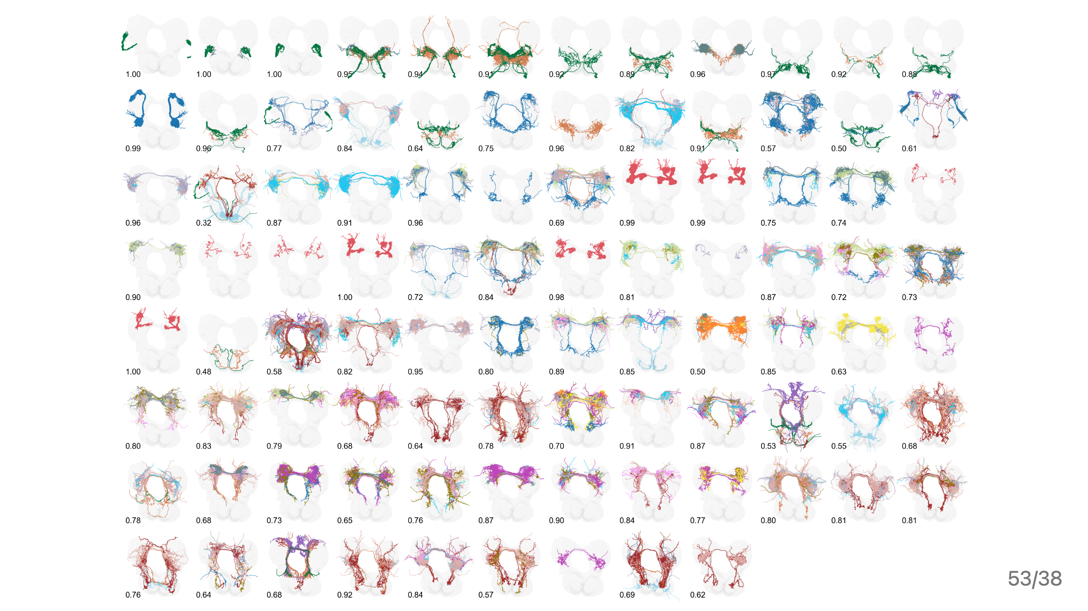
Notes:
### Cluster morphology

Slide 54
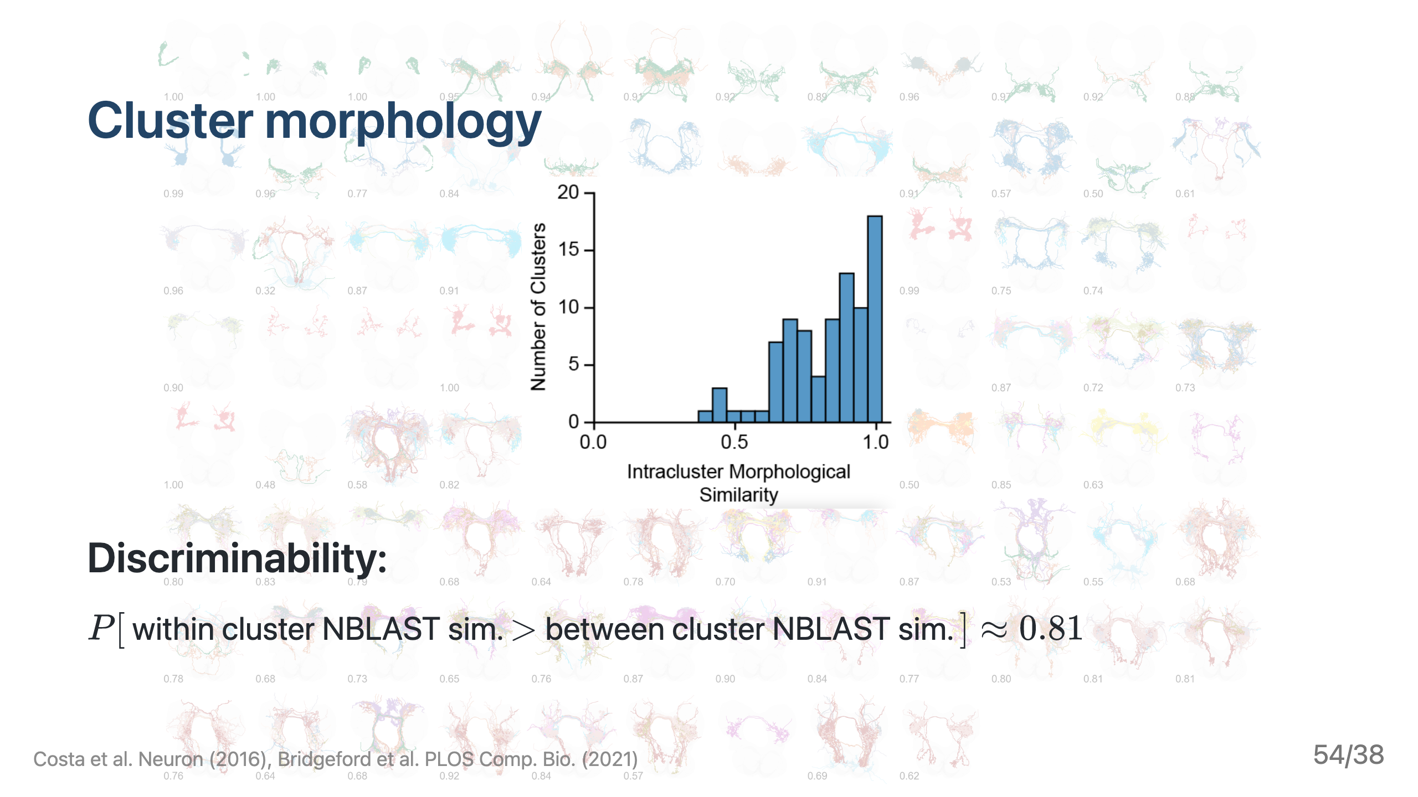

Slide 55
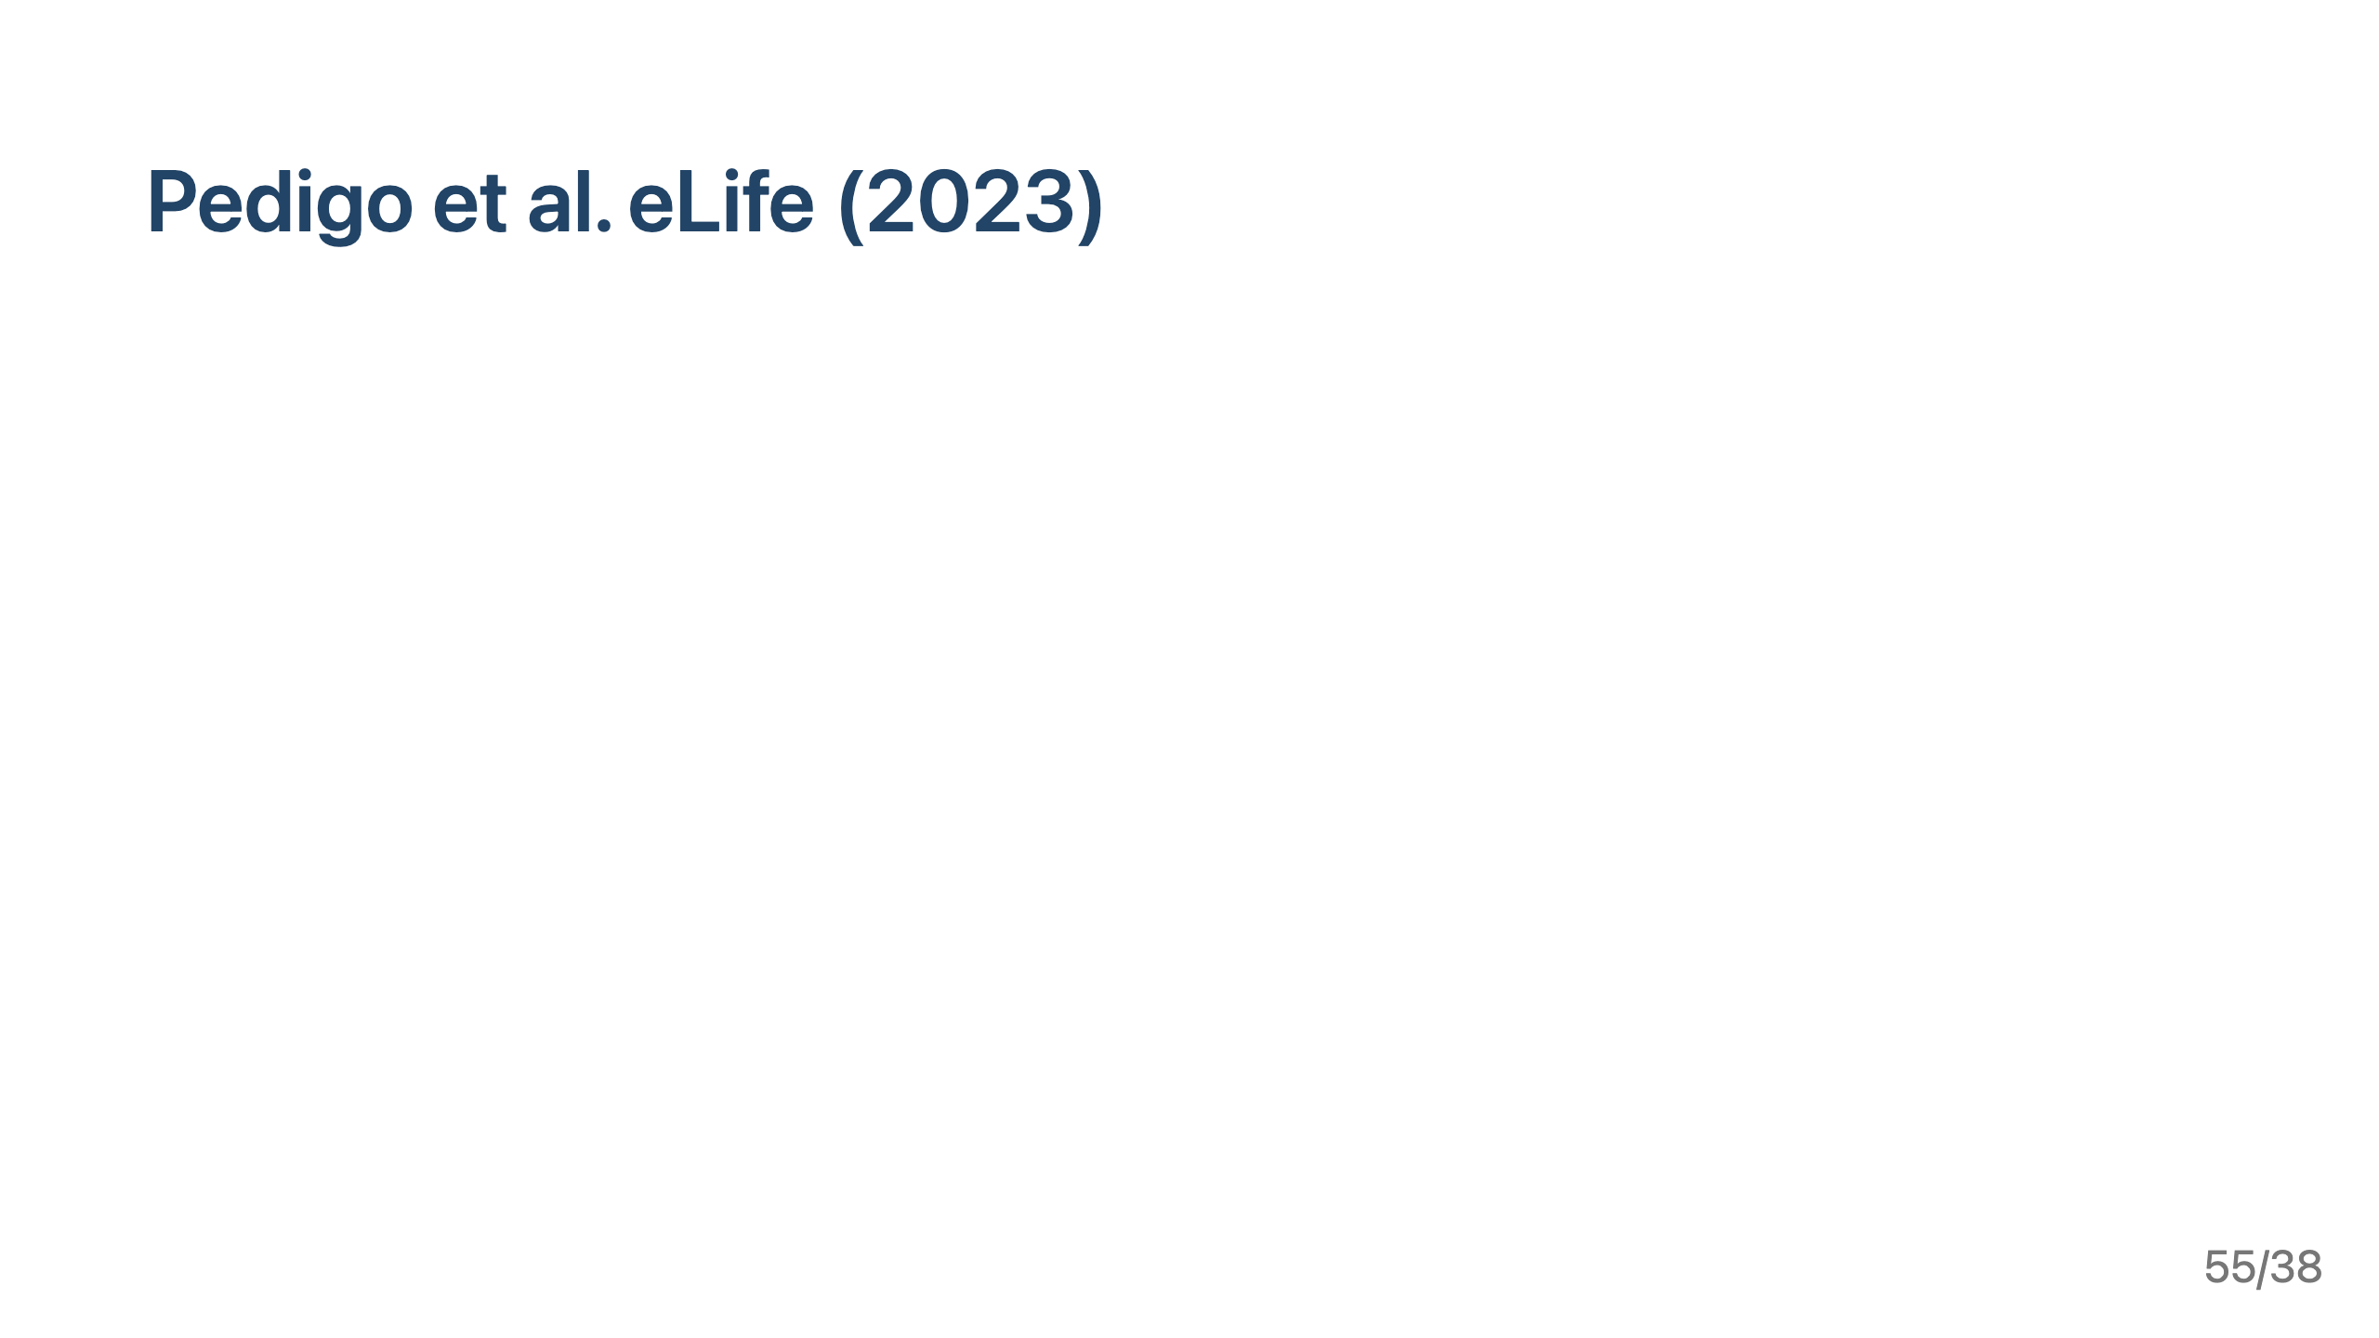

Slide 56
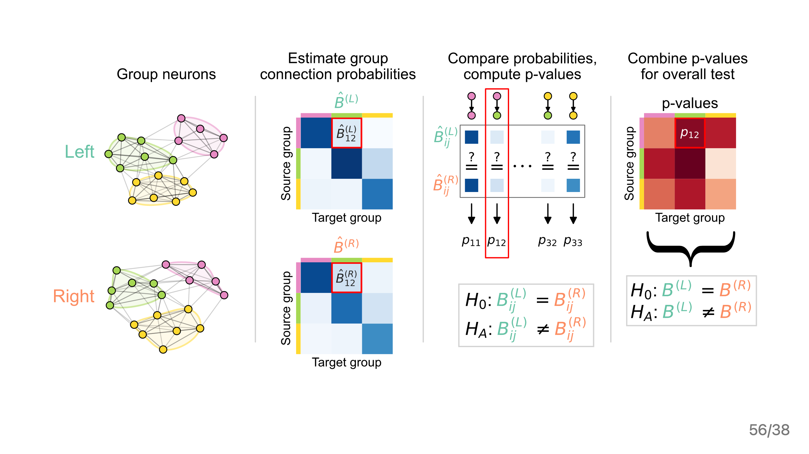

Slide 57


Slide 58


Slide 59


Slide 60


Slide 61


Slide 62


Slide 63


Slide 64


Slide 65


Slide 66


Slide 67


Slide 68


Slide 69


Slide 70


Slide 71


Slide 72


Slide 73


Slide 74

Notes:
--- # This split induces 4 graphs (or layers) <div class="columns"> <div> ![h:500](./../../images/fig2d.png) </div> <div> ![h:200](./../../images/fig2e.png) </div> </div> # What are these different "channels" doing? <div class="columns"> <div> ![h:500](./../../images/figS5e.png) </div> <div> </div> </div> --- # Sorting the network ![h:400 center](./../../images/flow-method-explain.png) --- # Comparing independently sorted "channels" ![bg right:68% h:650](./../../images/figs6.png) --- # Edge reciprocity ![h:400 center](./../../images/fig2h-reciprocity.png) _footer: Winding, Pedigo et al. bioRxiv (2022)

Slide 75


Slide 76


Slide 77


Slide 78


Slide 79


Slide 80


